Slide 1
Cartograms and Choropleth maps: an investigation into communicative effectiveness using mobile app usage data.
Henry Holbrook and Clive Cartwright
BCS ‐ SoC Conference
Mapping Together
8th-10th September 2015 · York

Slide 2
App Development
Visualising
The Test
Effectiveness
The Results
Conclusion & Future Work

Slide 3
App development

Slide 4
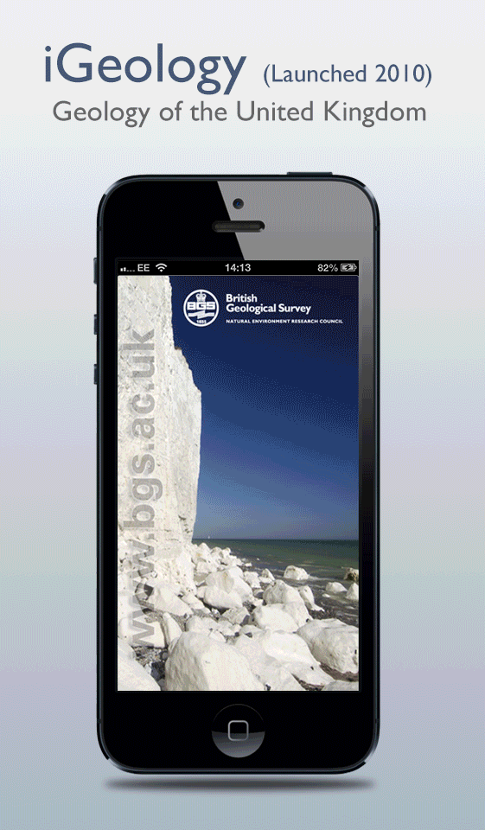
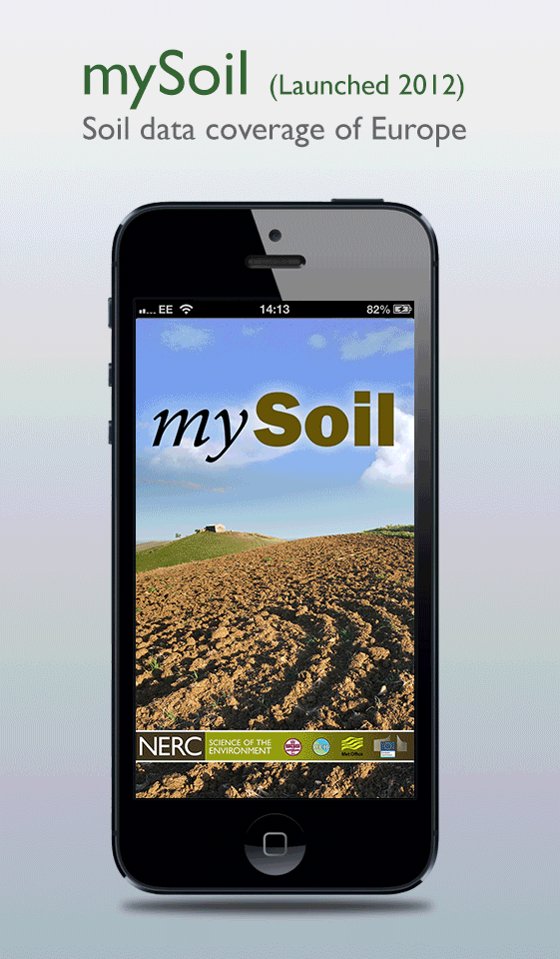
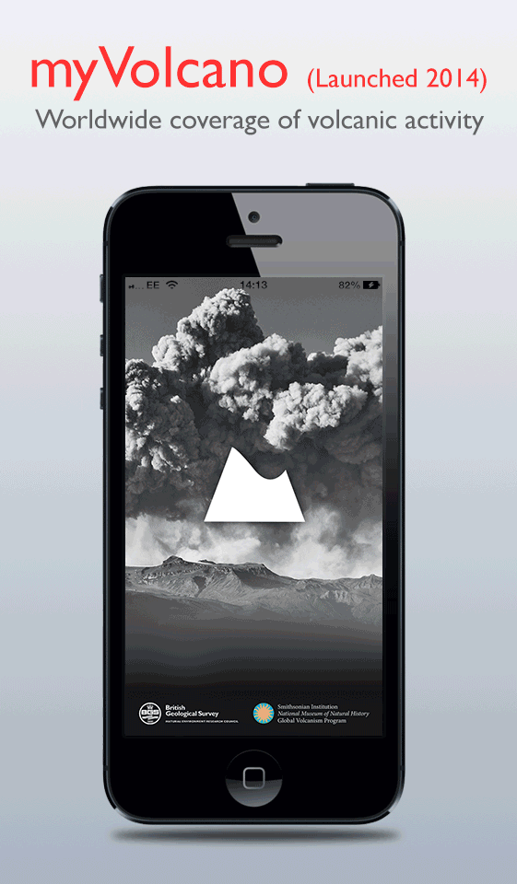
BGS mobile app development
Notes:
The BGS has been busy releasing apps as a part of a desire to make our data more accessible to the public.
What apps BGS has, when released, and how it has developed in terms of crowdsourcing.

Slide 5
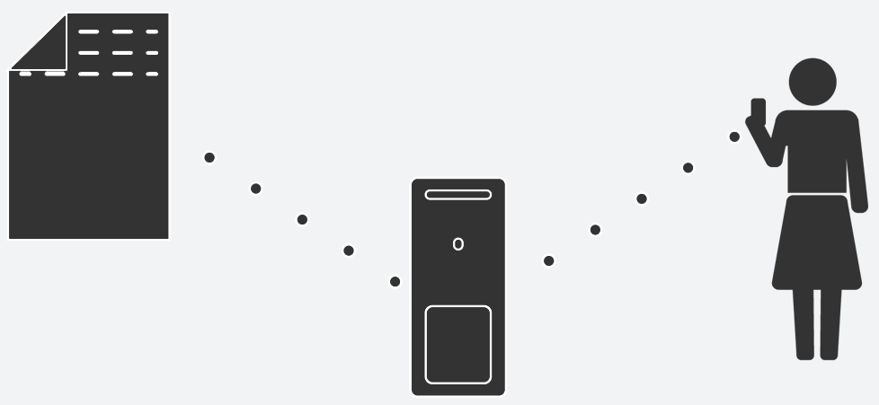
Recording mobile app usage
Notes:
However, we needed to evaluate just how successful these apps were, and try and gain an insight in to how they were being used.
Server side Log files showing Zoom 14.
iGeology 500 daily users, with 50 new ones.

Slide 6
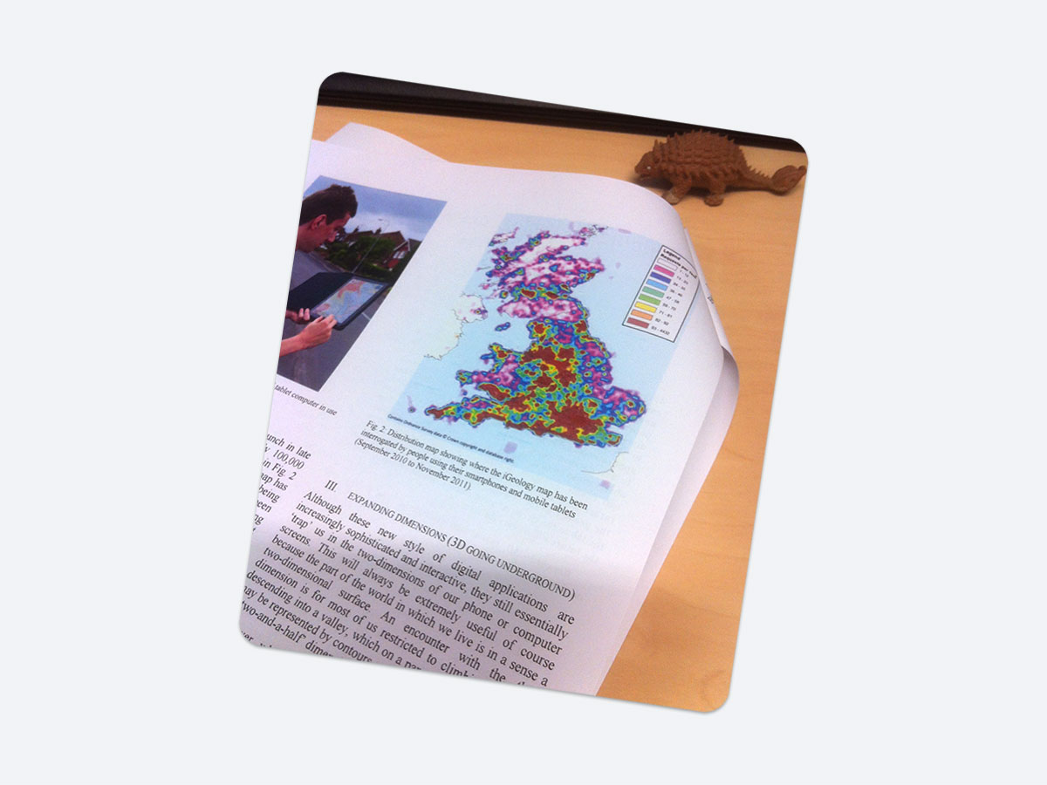
Notes:
Result at the time: An Inverse Distance Weighted (Heat map).
It’s limitations: next slide…

Slide 7
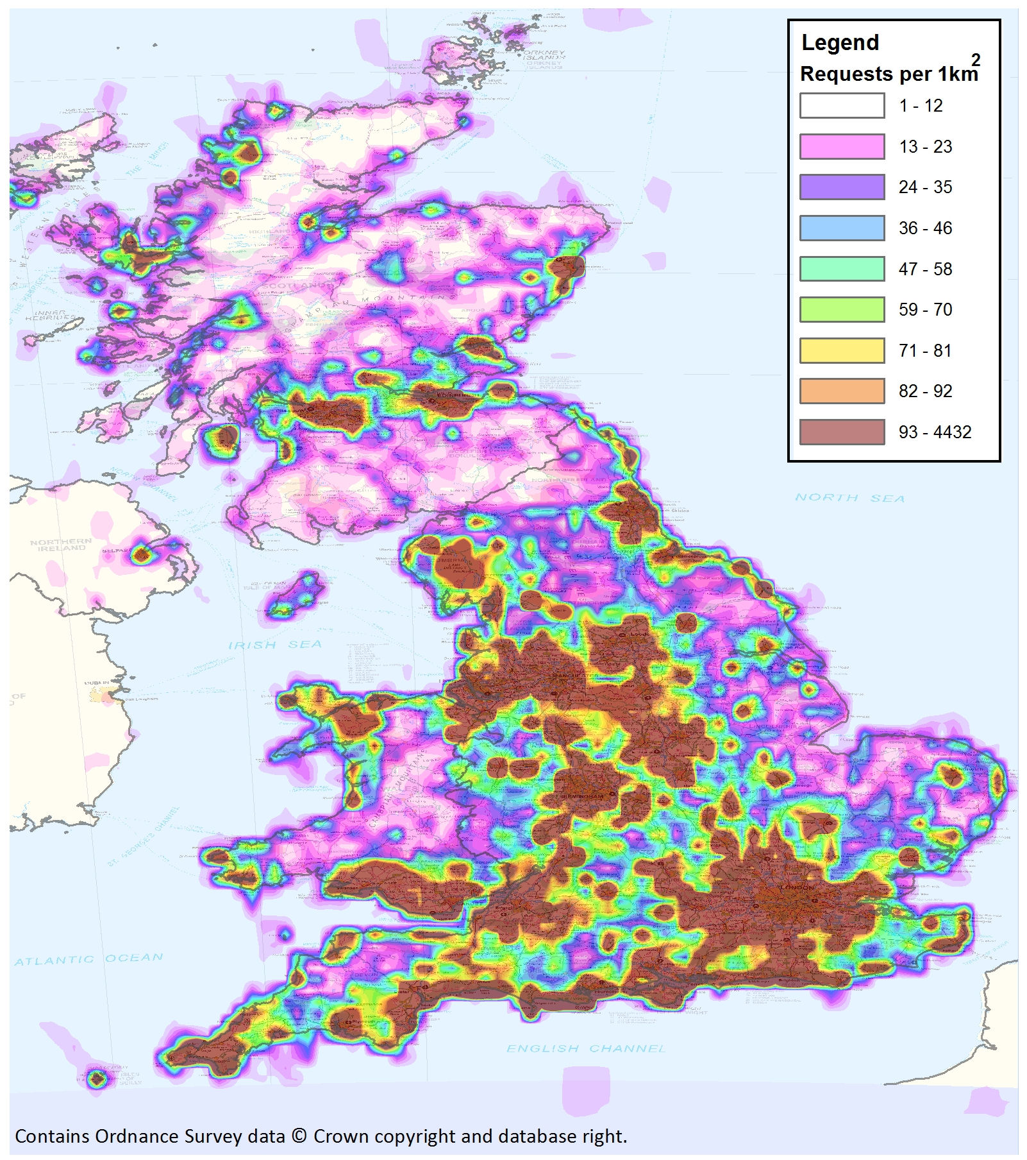
Notes:
Inverse Distance Weighted (Heat map) and it’s limitations:
Displaying the raw tile download data saturates the map, requiring a narrow bandwidth of data density in order to show anything. This map only shows 2% of the data range.
However, the result generally reflects the distribution of population, leaving no distinction for app activity above a certain threshold (i.e. London).

Slide 8
Visualising

Slide 9

Visualising depends on…
communicating…
Visualising

Slide 10

Visualising depends on…
communicating…
by appropriate means…
Visualising

Slide 11

Visualising depends on…
communicating…
by appropriate means…
in a suitable format for the story and the audience
Visualising
Notes:
Our need was to create maps that could be used statically. The purpose of the study was to investigate how static maps were read for example if they were used in a poster where its essential that the information can be communicated efficiently.
We often require static images for posters, reporting our findings to the public and reporting what’s happening to the executive. It was important that we able to communicate quickly and give an impression of what’s happening.

Slide 12
The alternatives
Our research revealed that there were two other types of maps that would be capable of communicating this type of data.
Visualising
Notes:
Revealing app usage alone did not reveal answers to questions that posters and journal articles are likely to need to display. We need to display more than one level of information and these map types are ones that are capable of handling this data.

Slide 13
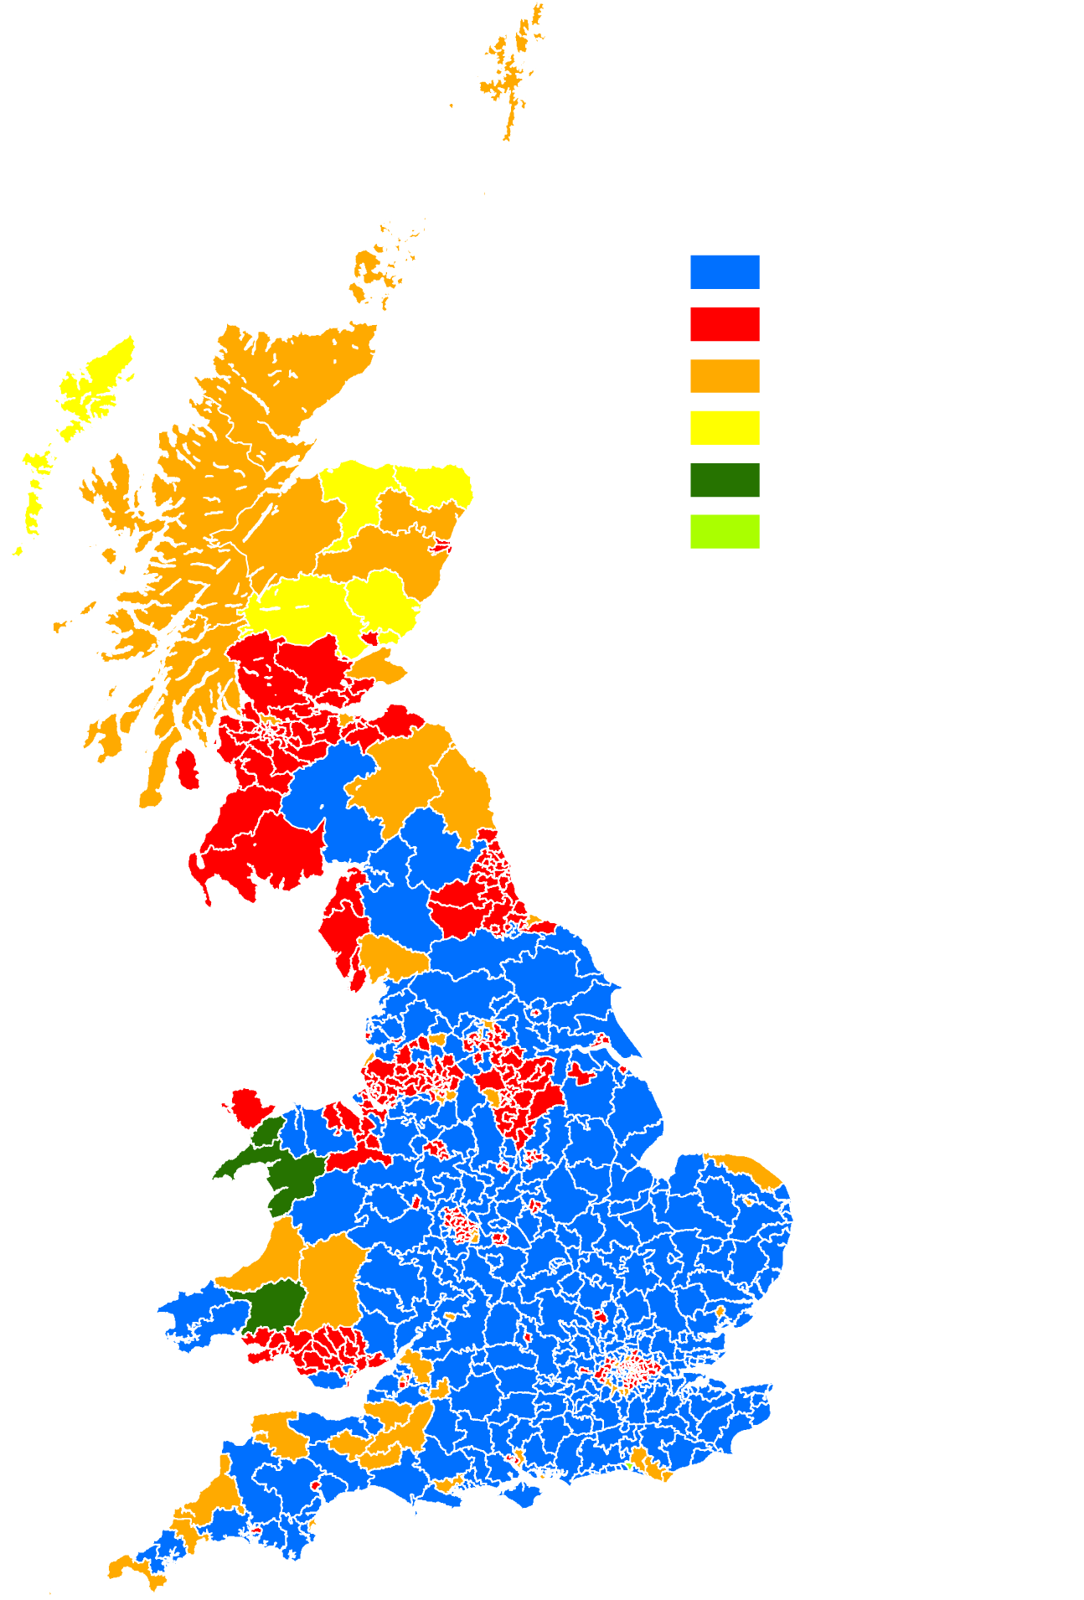
The alternatives
British election results map (2010)
Visualising

Slide 14
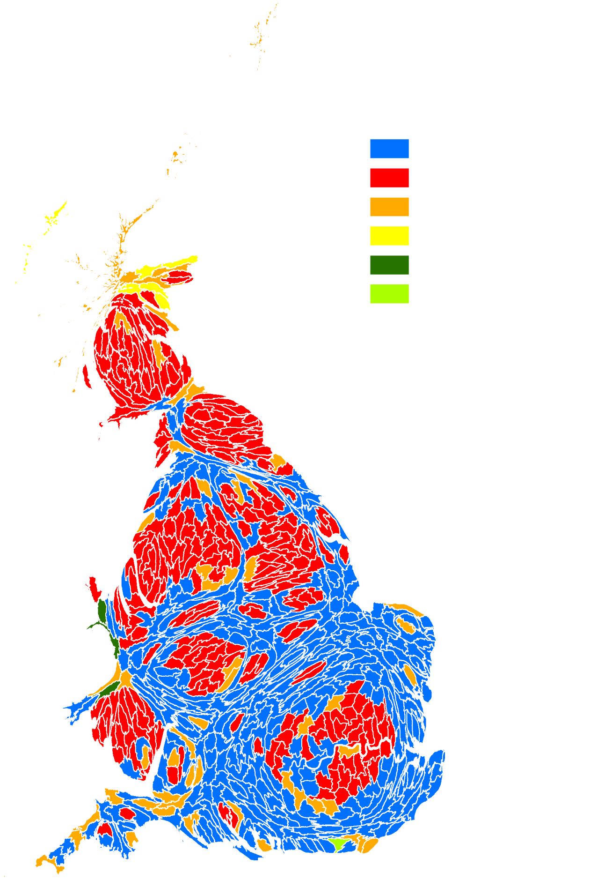
The alternatives
British election results proportional to population (2011).
Visualising
Notes:
Cartogram – can’t use any data!

Slide 15
Why?
We need to understand how the data is being used
Identify areas of interest
But not just to highlight areas that are populated
Reveal how the data or app could be developed
Combined with other information that in context will help give the data meaning
Visualising
Notes:
Because we want to see how BGS can display information that isn’t extensively used. The only way to gauge what works best is to perform a test on both map types.
Business intelligence is revealed from how the app is used.
This will include areas of interest that could be apparent as revealed in the heatmap or other areas of interest only revealed in other visualisation types
The visualisation should reveal more than just the obvious.
Combining with other datasets could help answer more questions than just relying on the information that BGS has. The addition of a social aspect ensures that the data has meaning and relevance as well as revealing how the data has been used.

Slide 16
How?
Identify data sources –
  parliamentary constituencies
  App usage zoom level
  Population data
Decide how all of this information can be visualised in both map types
What types of questions would people ask from the data?
Create a usage to people ratio
Visualising
Notes:
The data sources are critical for creating a suitable visualisation that will answer specific questions. Datasets have to be made to work together which can be difficult.
Parliamentary constituencies were chosen as the most suitable to give a fair representation of how many people live in those areas. They have a similar amount of voters for each constituency. Parliamentary constituencies as they roughly have the same number head count per region.
All levels of data are recorded as you zoom in and out on the app. Zoom level 14 is the most detailed and is actually where people start to use the data.
Population data would also be used for knowing exactly how many people live in each area.
We then had to decide how all of this information could be displayed in both map types. The cartogram could handle all the data in one map (shape and colour) whereas the choropleth would need two maps to display the information (colour). A pattern could also be used but this would cause confusion.
With this data a usage to people ratio was created which would combine this data to give a easier to handle statistic in the map. The data had to be processed before it was possible to make a visualisation – where the usage to people ratio was used to try to make the data more understandable.
To design something suitable we would have to think about the type of questions people would ask from the maps.

Slide 17
The Test
Notes:
Explain how the test was developed – initial explanation of map types, 4 groups, age groups, cartogram/choropleth mix. Order of maps and timing of questions. Qualitative comment on preference.
Number of participants
How were the maps created?
Study area?
The environment of the test
Map colours – colour blind

Slide 18


The Test
Notes:
Data – two of the apps (iGeology and mySoil) for a year snapshot

Slide 19


The Test
Notes:
Define an area – we wanted to avoid bias due to familiarity or knowledge of an area, before the test.

Slide 20
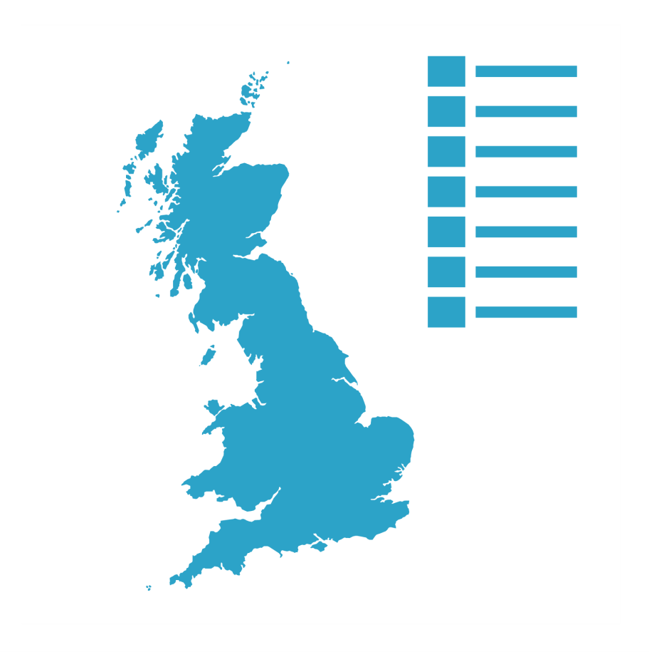
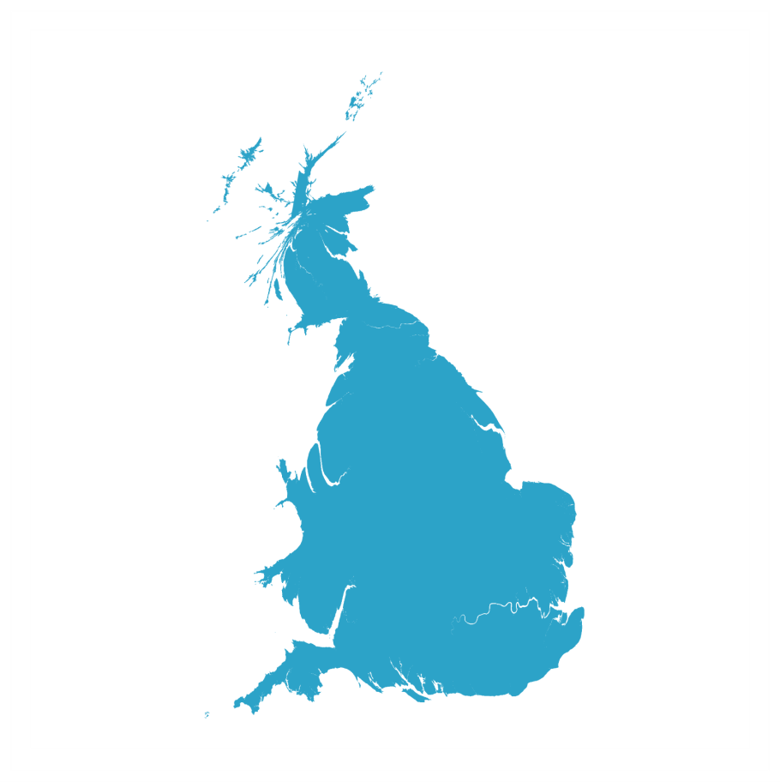
The Test

Slide 21


The Test

Slide 22

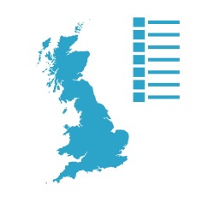
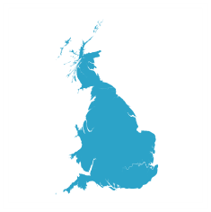
The Test

Slide 23
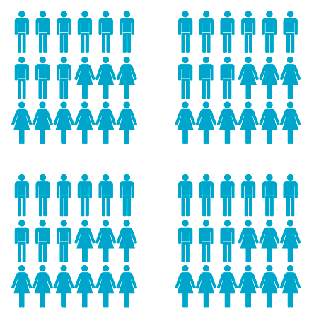
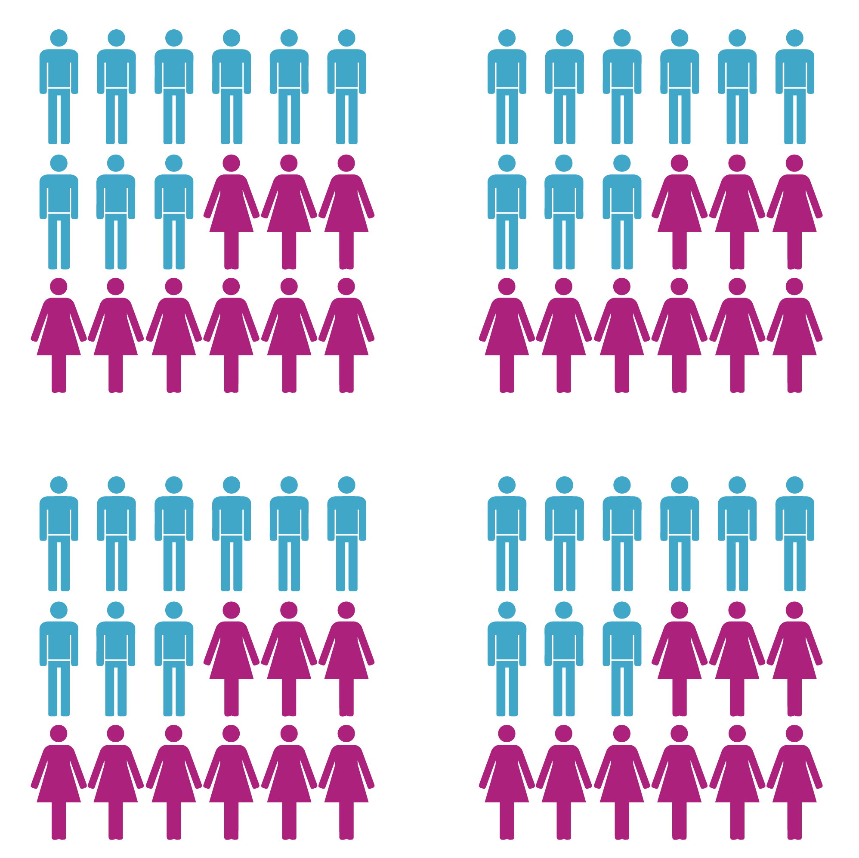
The Test

Slide 24
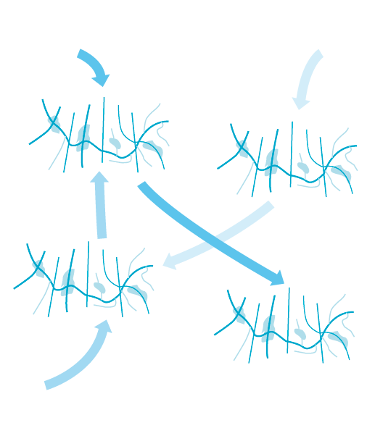
The Test

Slide 25


The Test
Notes:
Educate – before the test began we gave an introduction to each map type to give a level playing field.
Then for each map type the participant was given a couple of minutes to read then map.
Timing only began for each question as they were given it.

Slide 26

The Test

Slide 27
Effectiveness
Notes:
So, we have the results… how do we interpret them?

Slide 28
Test objective:
Establish if the maps communicate. Not interested in absolute answers as they bias cartograms.
Rationalizing usage data with population statistics.
Establish if the linking method reduces communicative effectiveness.
Questions
Notes:
The aim of the test was to establish if these maps communicated the message. We weren’t interested in absolute answers, an answer in the general area was considered to be a positive result; as an absolute answer would bias away from the choropleth map due to the nature of aggregation into range classes.
To help improve readability, rationalizing the usage data with population statistics shown via a specially prepared colour ramp designed with colour blind users in mind, was considered ideal for the job.

Slide 29
3 direct questions relating to the map:
Out of the highest populated areas which area had the least app use?
Out of the lowest populated areas which area had the most app use?
Which region performed best overall?
Questions

Slide 30
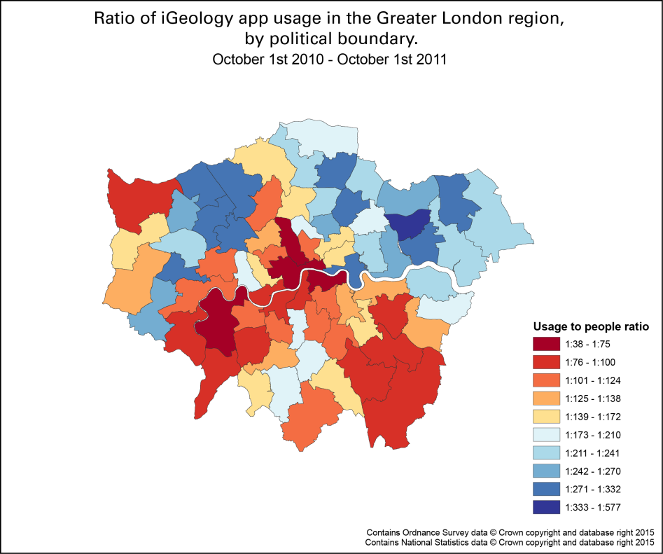
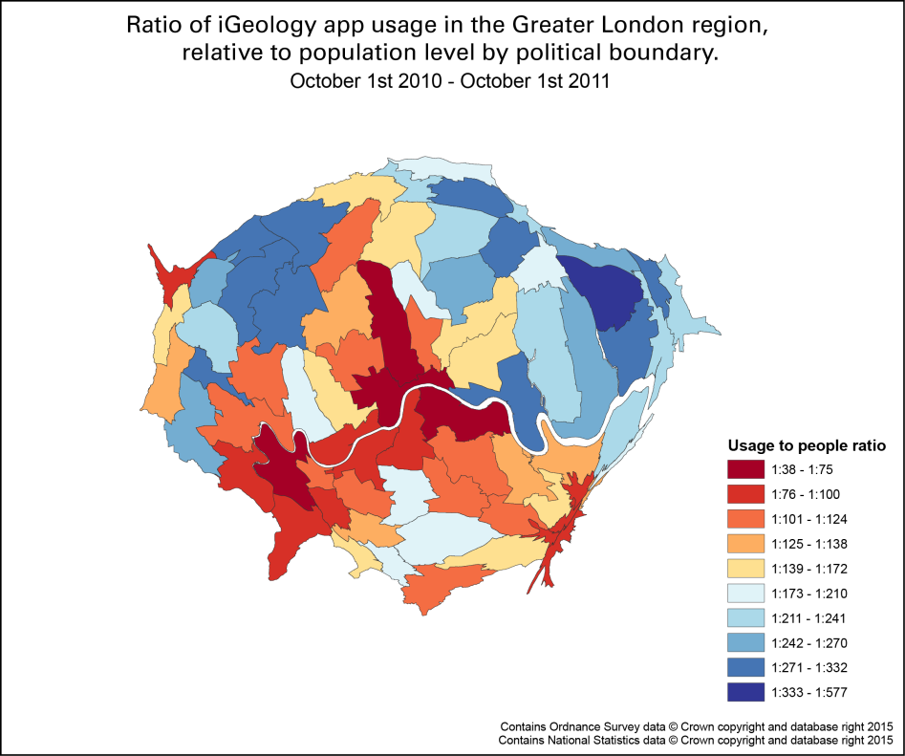
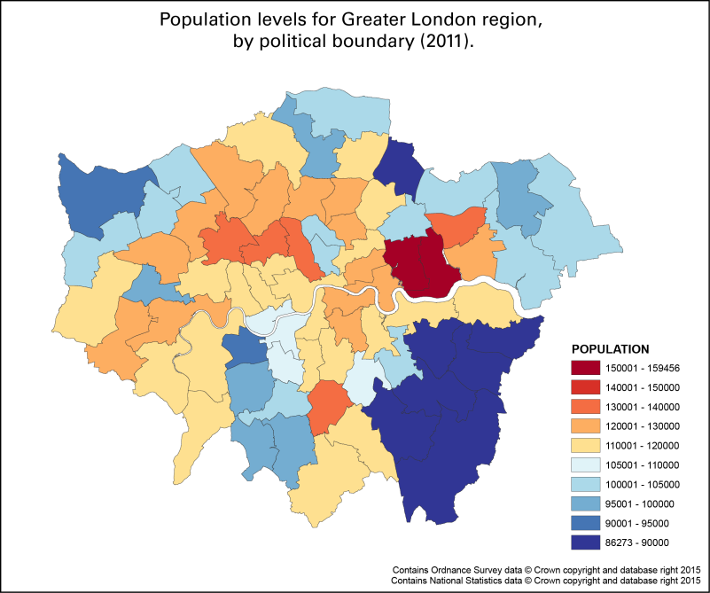
Which region performed
best overall?
Notes:
Above are examples of what the participants used to help answer questions based on iGeology app activity.

Slide 31
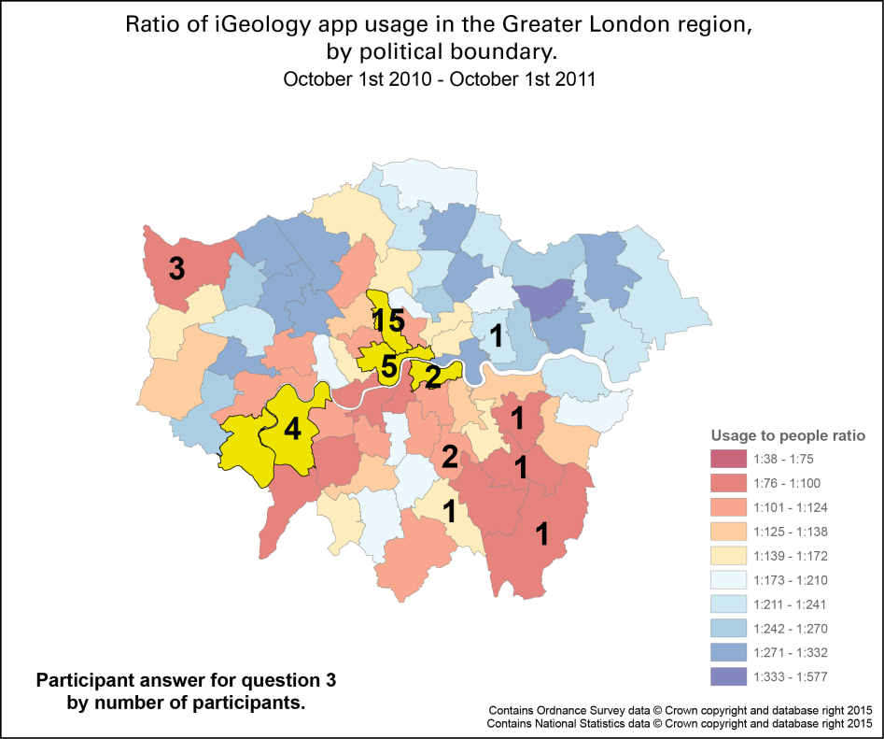
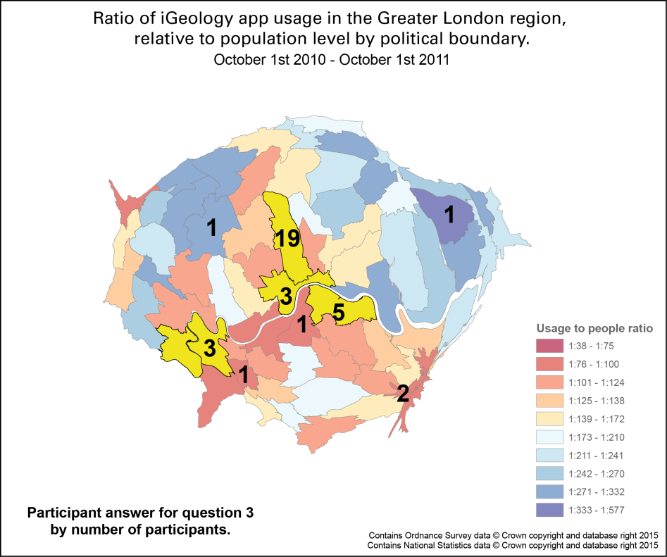
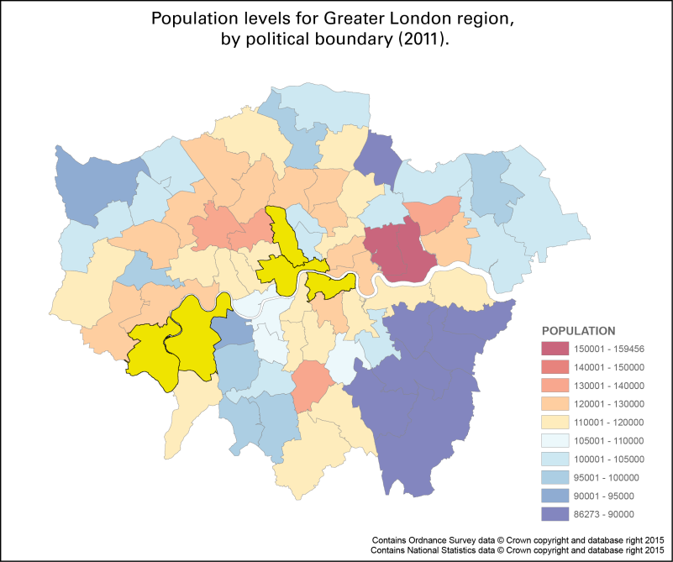
Which region performed
best overall?
Notes:
The results are shown by the number participants. The 5 most accurate answers for question 3 (Which region performed best overall?) are highlighted in yellow. Anyone who chose a polygon in this 7% was deemed as reading the maps correctly.
For questions 1 and 2, the population level was ranked between 1 and 72 and the ratio (Ratio mode usage) ranked between 1 and 73. 73 being the most favoured outcome (So if the question related to lowest population, the lowest popn polygon would be 73…whereas if the question was the highest popn, the highest popn polygon would be ranked at 73. The results were then multiplied to get the answers and calculate the top 5.

Slide 32
Other questions:
1) Gender
2) Age
3) Any visual impediments
4) Self assessment on map reading abilities
and after the test
5) Map preference
Questions kept to a minimum to reduce participant fatigue
Questions

Slide 33
The Results

Slide 34
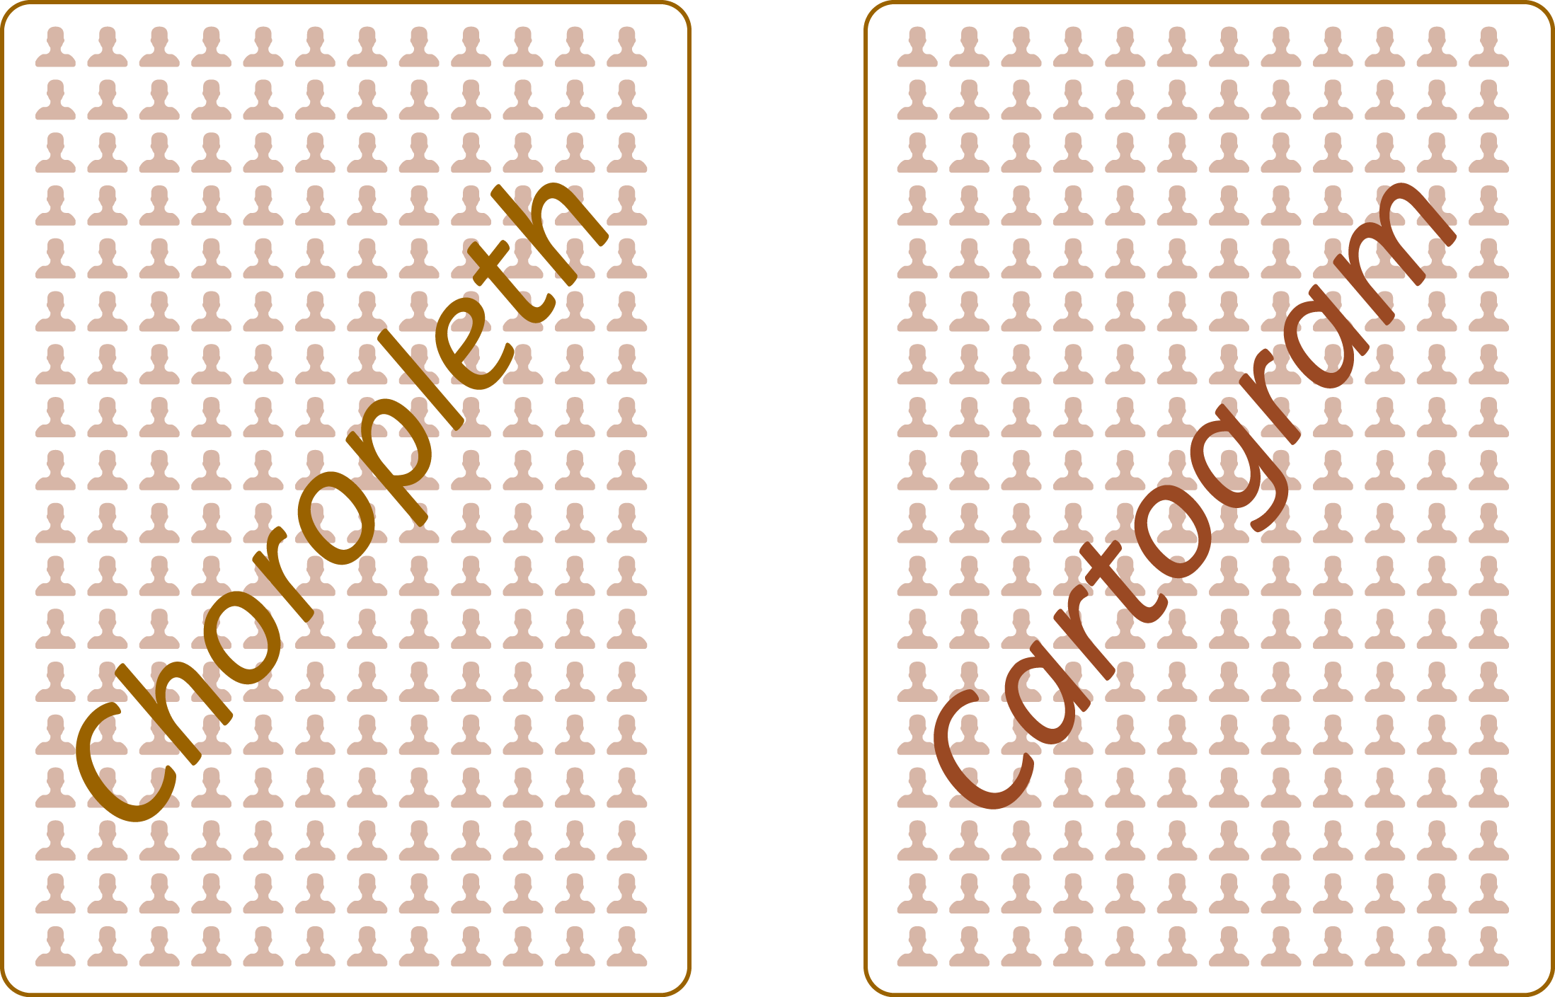
Which performed best?

Slide 35
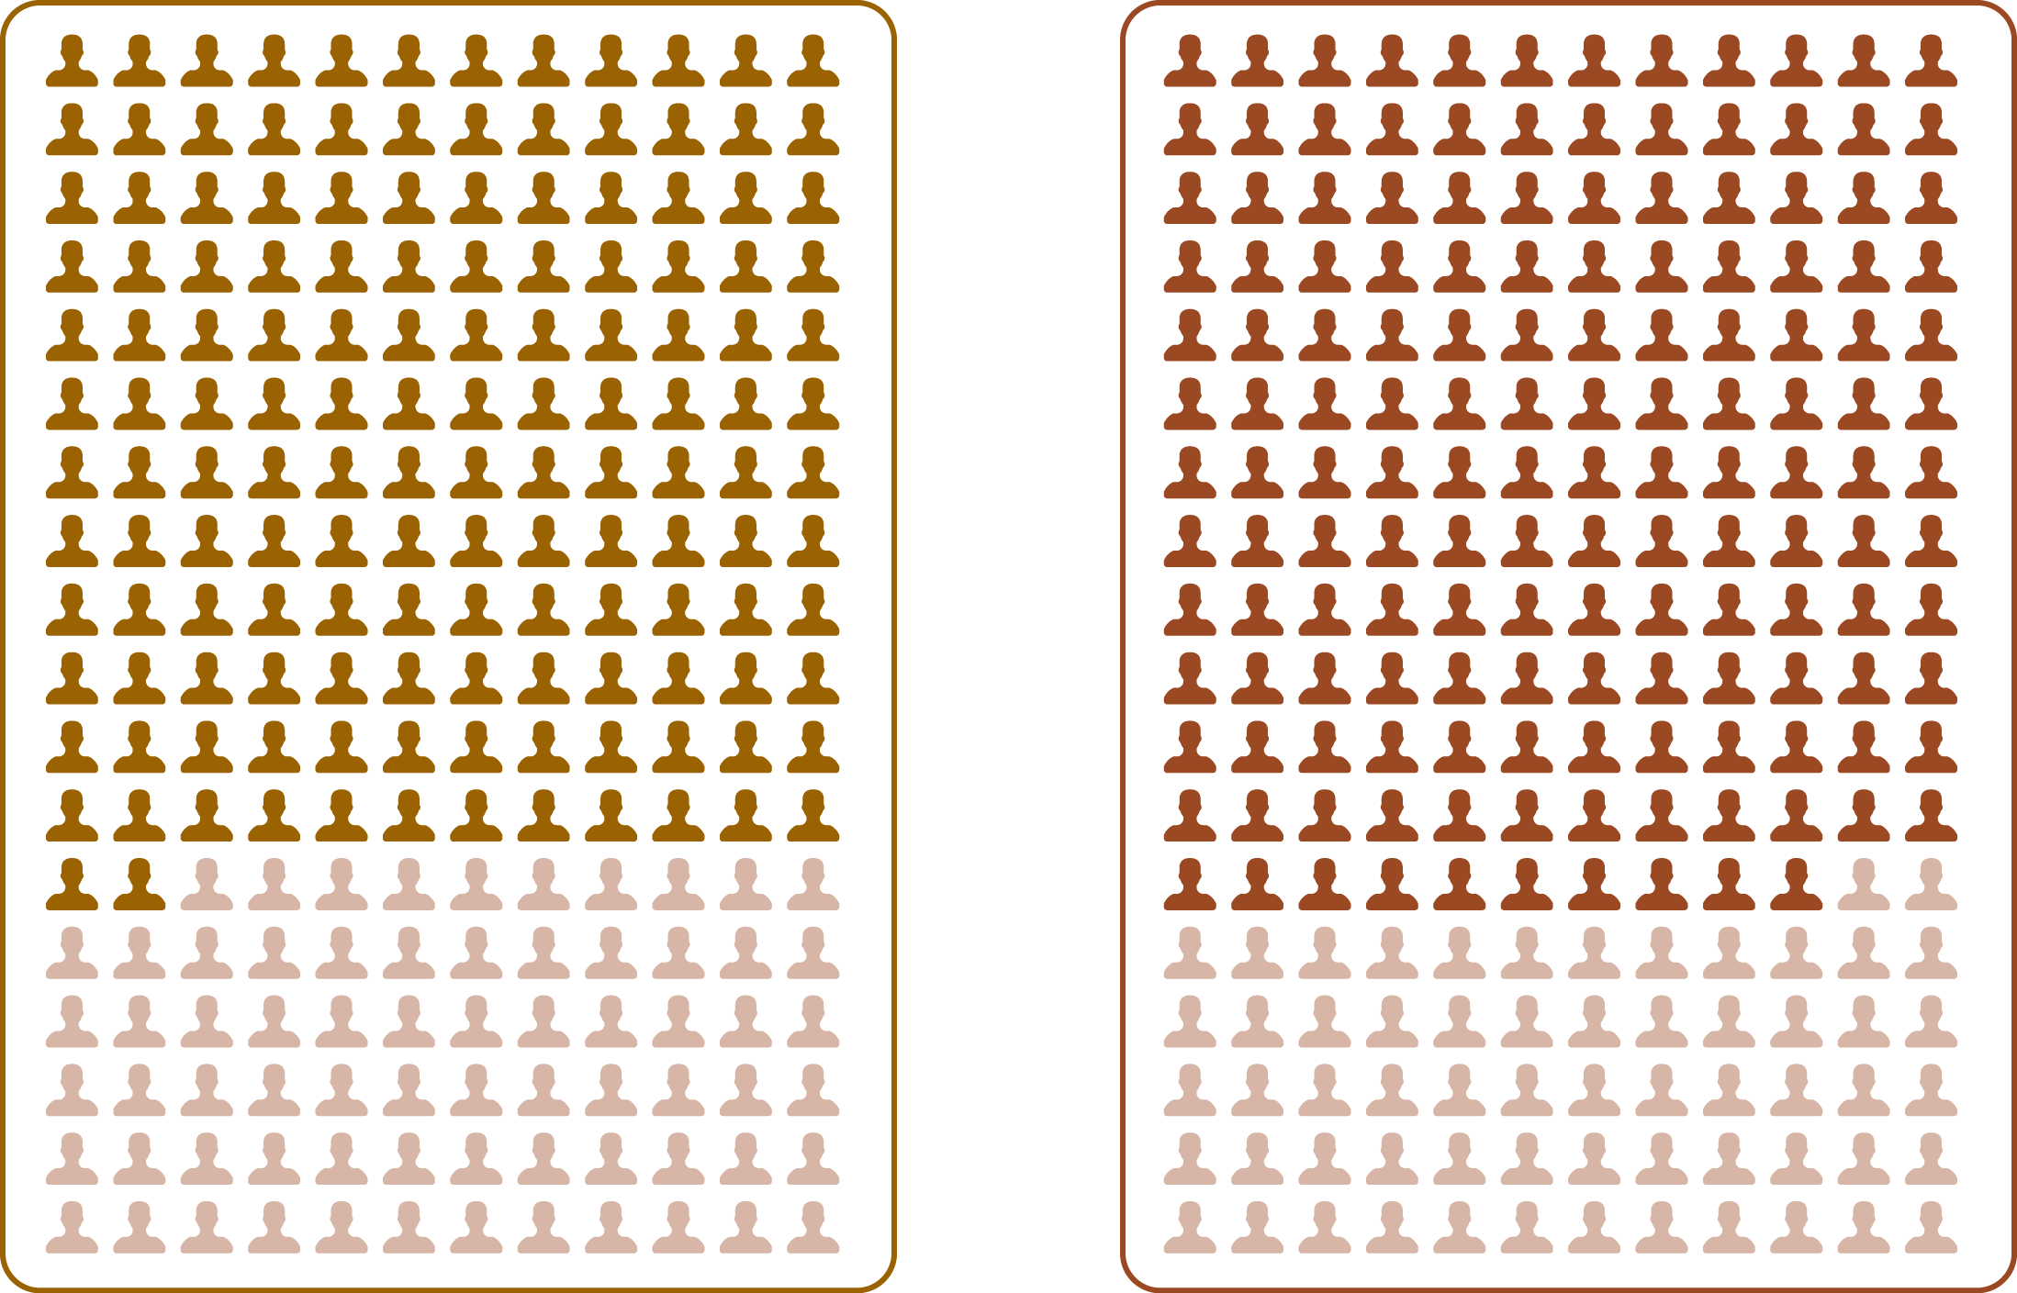
Which performed best?
Correct answer in the top 5 polygons for all questions

Slide 36
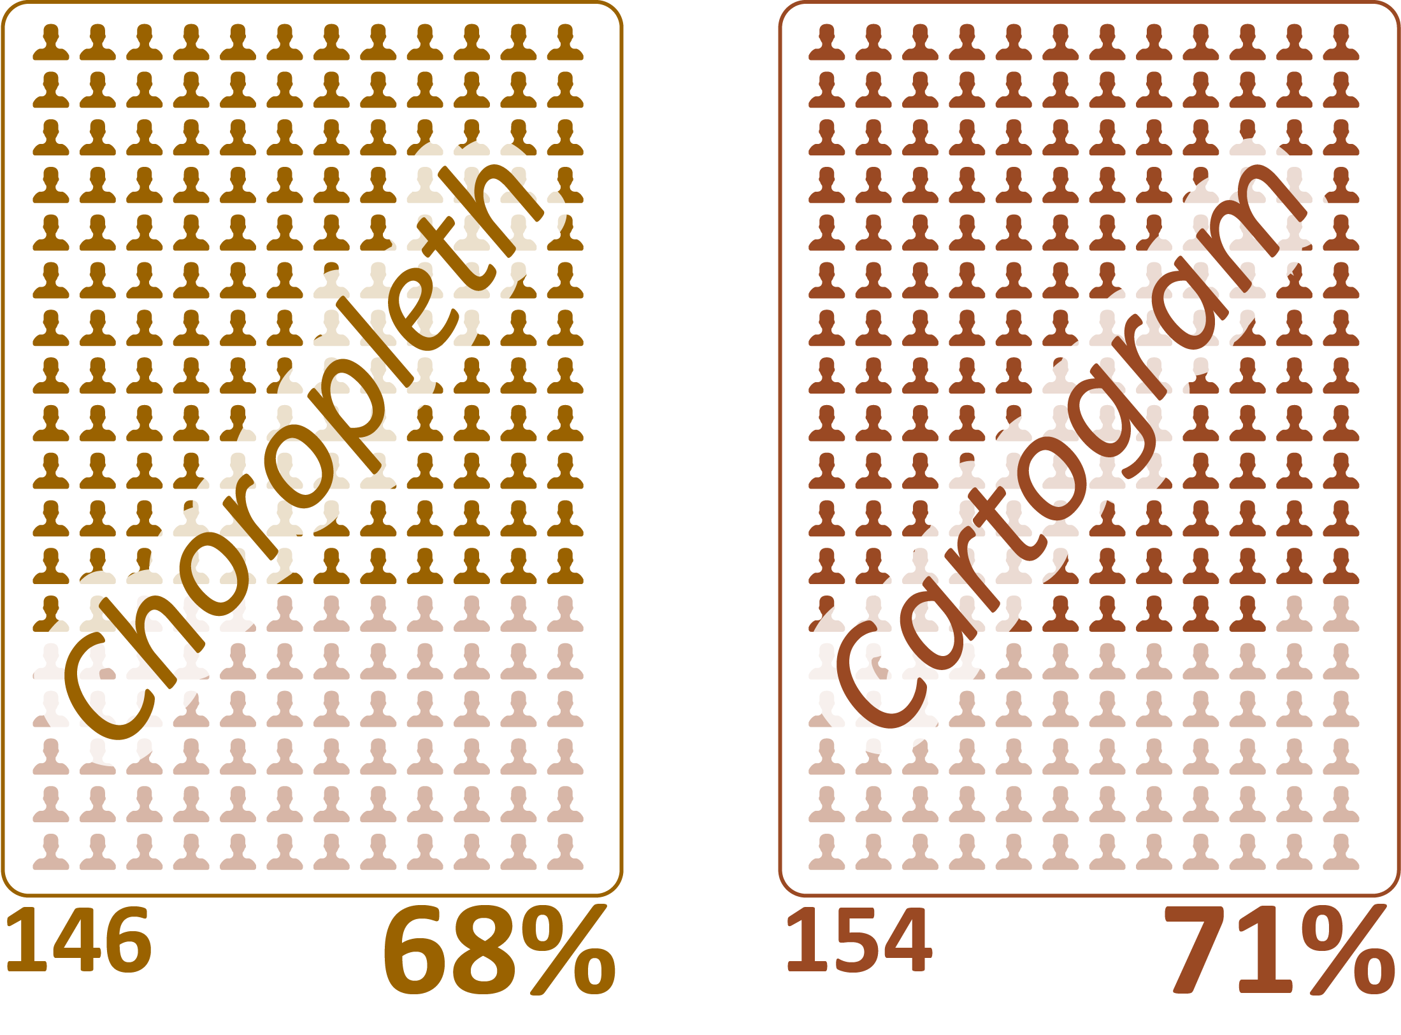
Which performed best?
Correct answer in the top 5 polygons for all questions

Slide 37
The Results
Order of maps

Slide 38
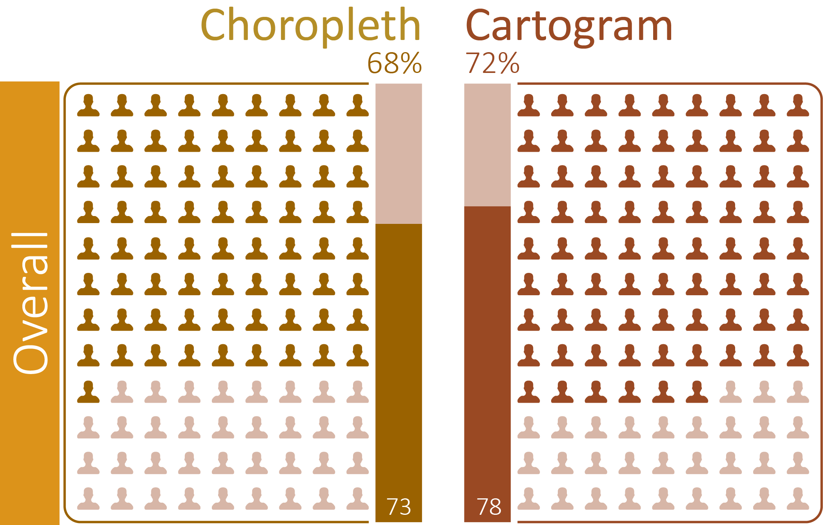
Order of maps – maps seen first
Correct answer in the top 5 polygons

Slide 39
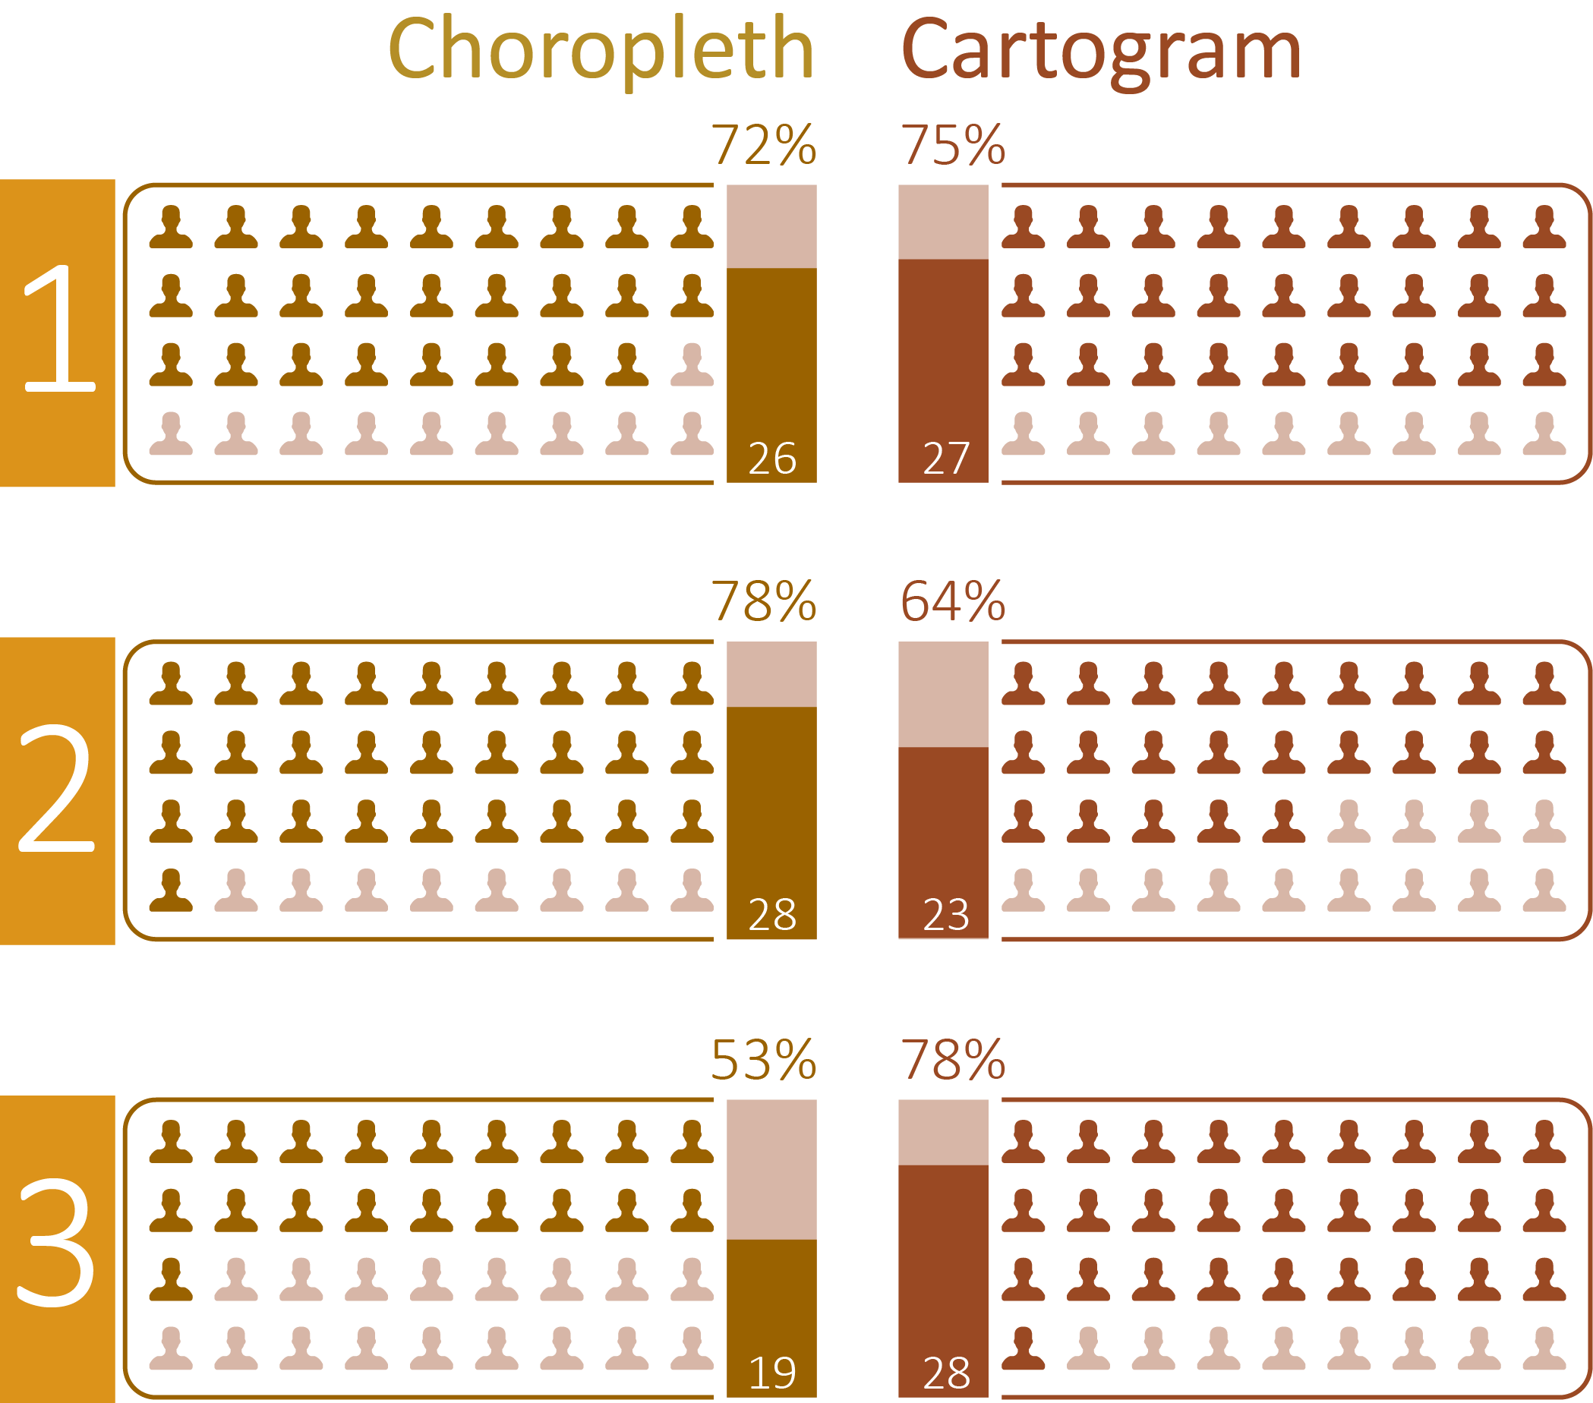
Order of maps – maps seen first

Slide 40
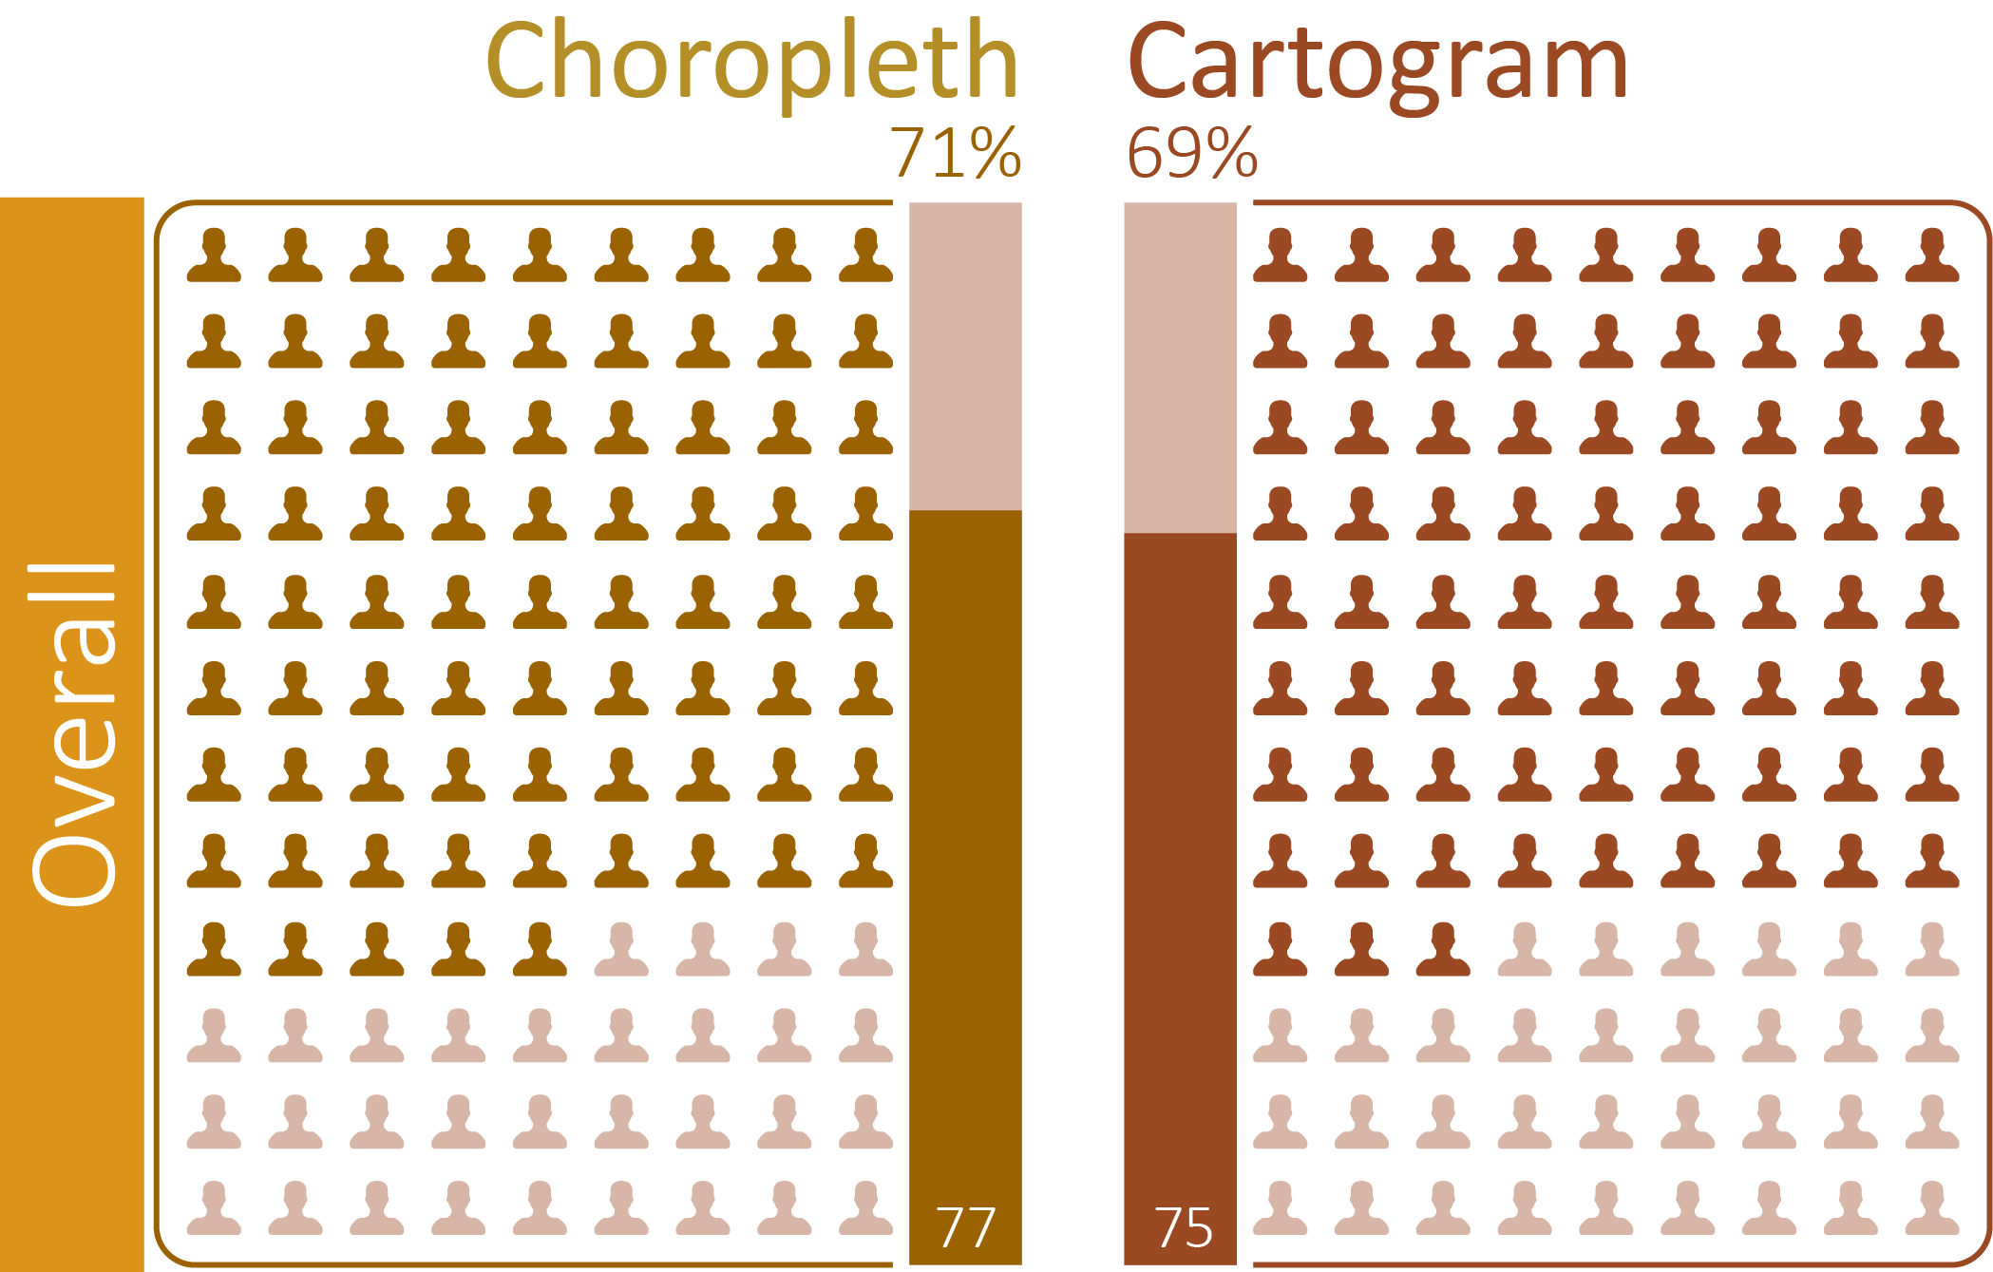
Order of maps – maps seen second
Correct answer in the top 5 polygons

Slide 41
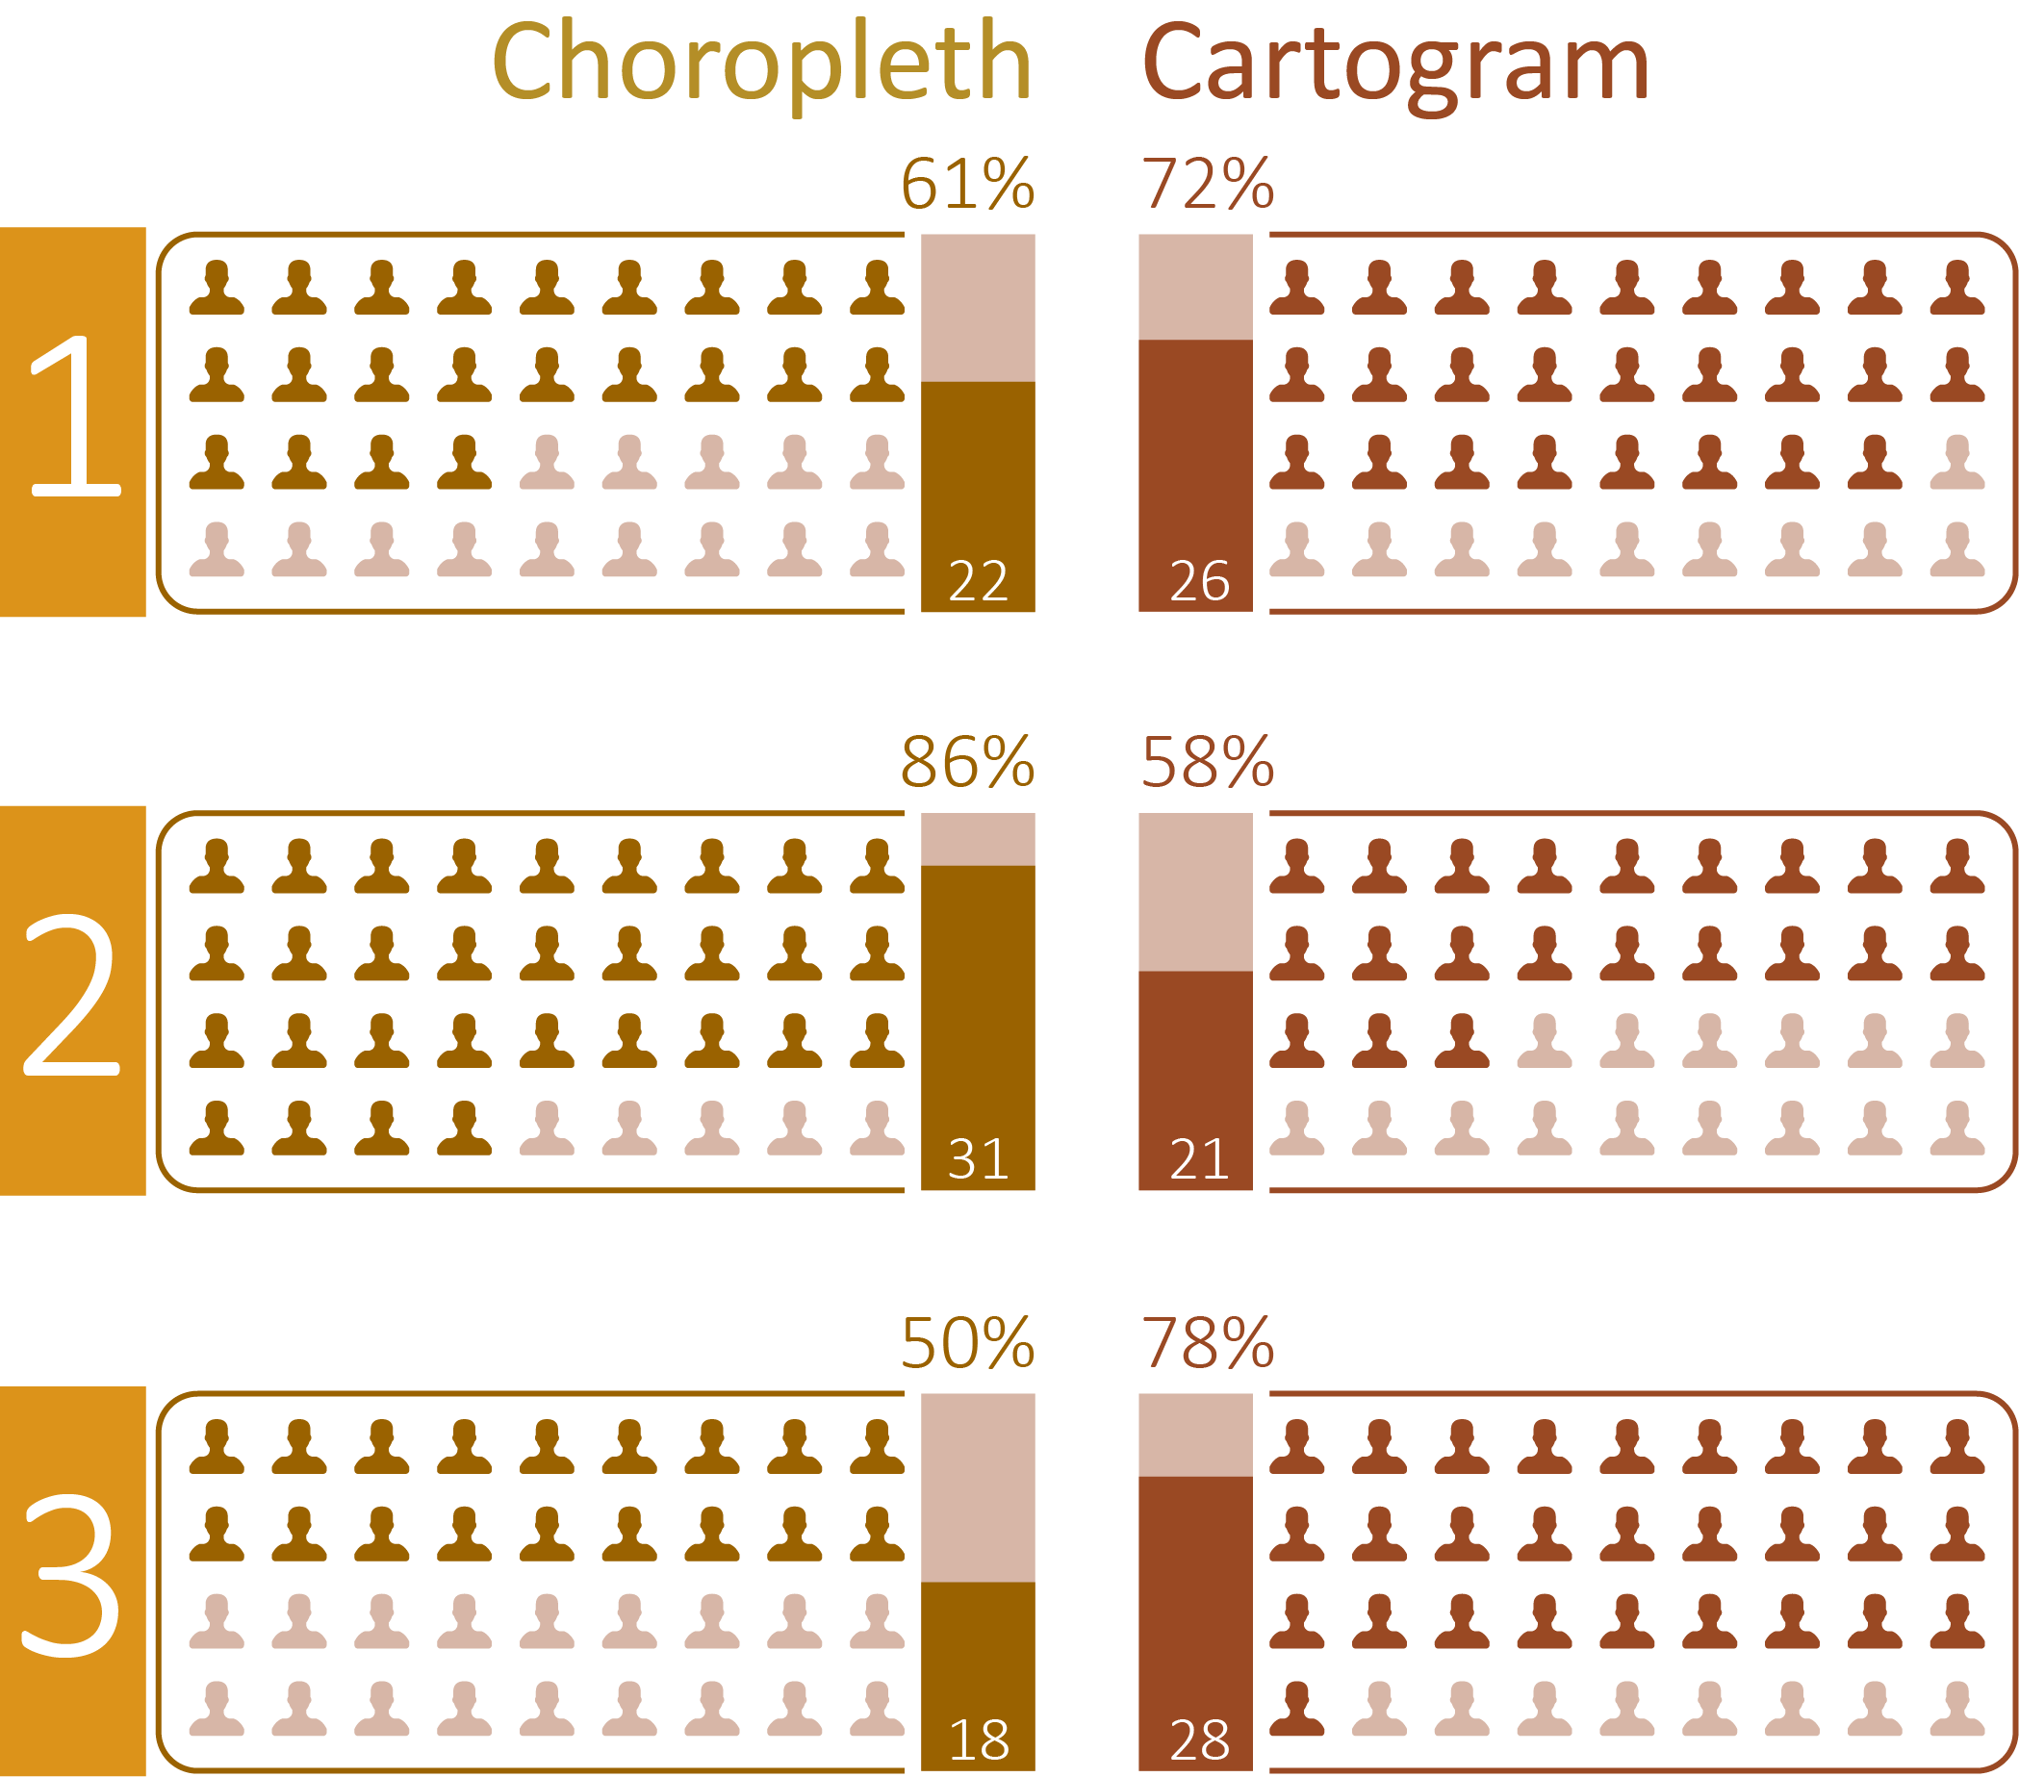
Order of maps – maps seen second

Slide 42
The Results
The questions

Slide 43
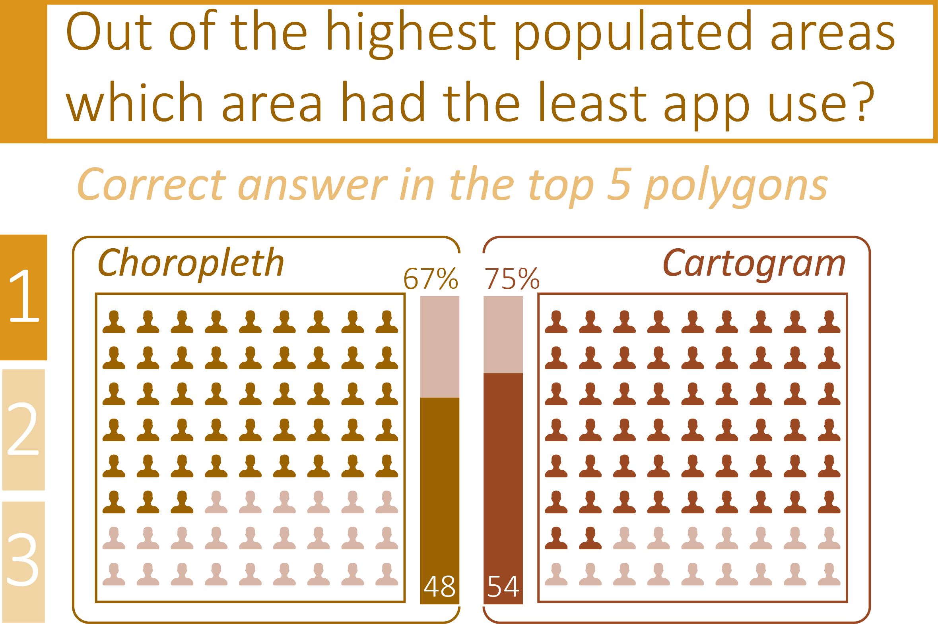

Slide 44
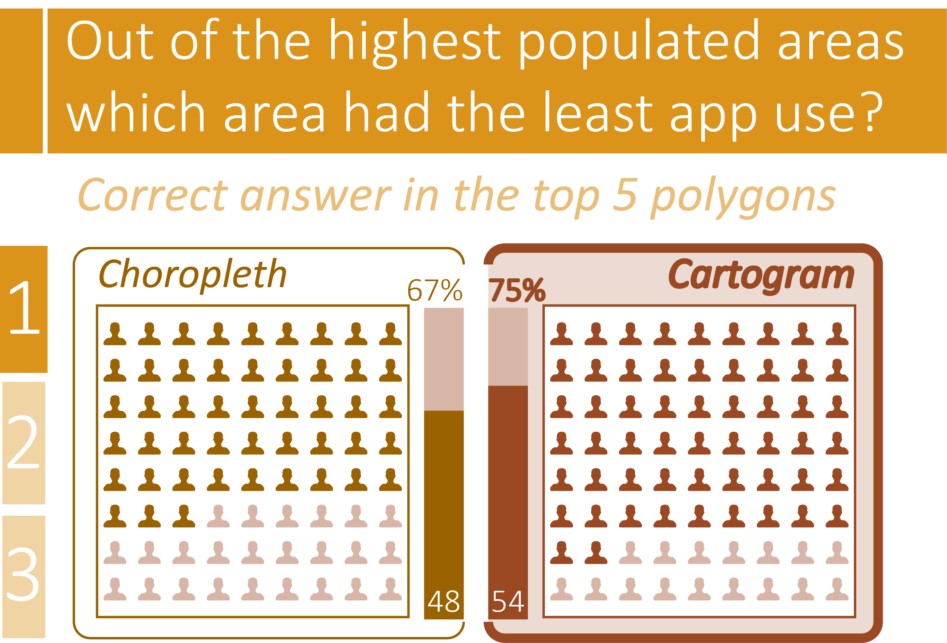

Slide 45
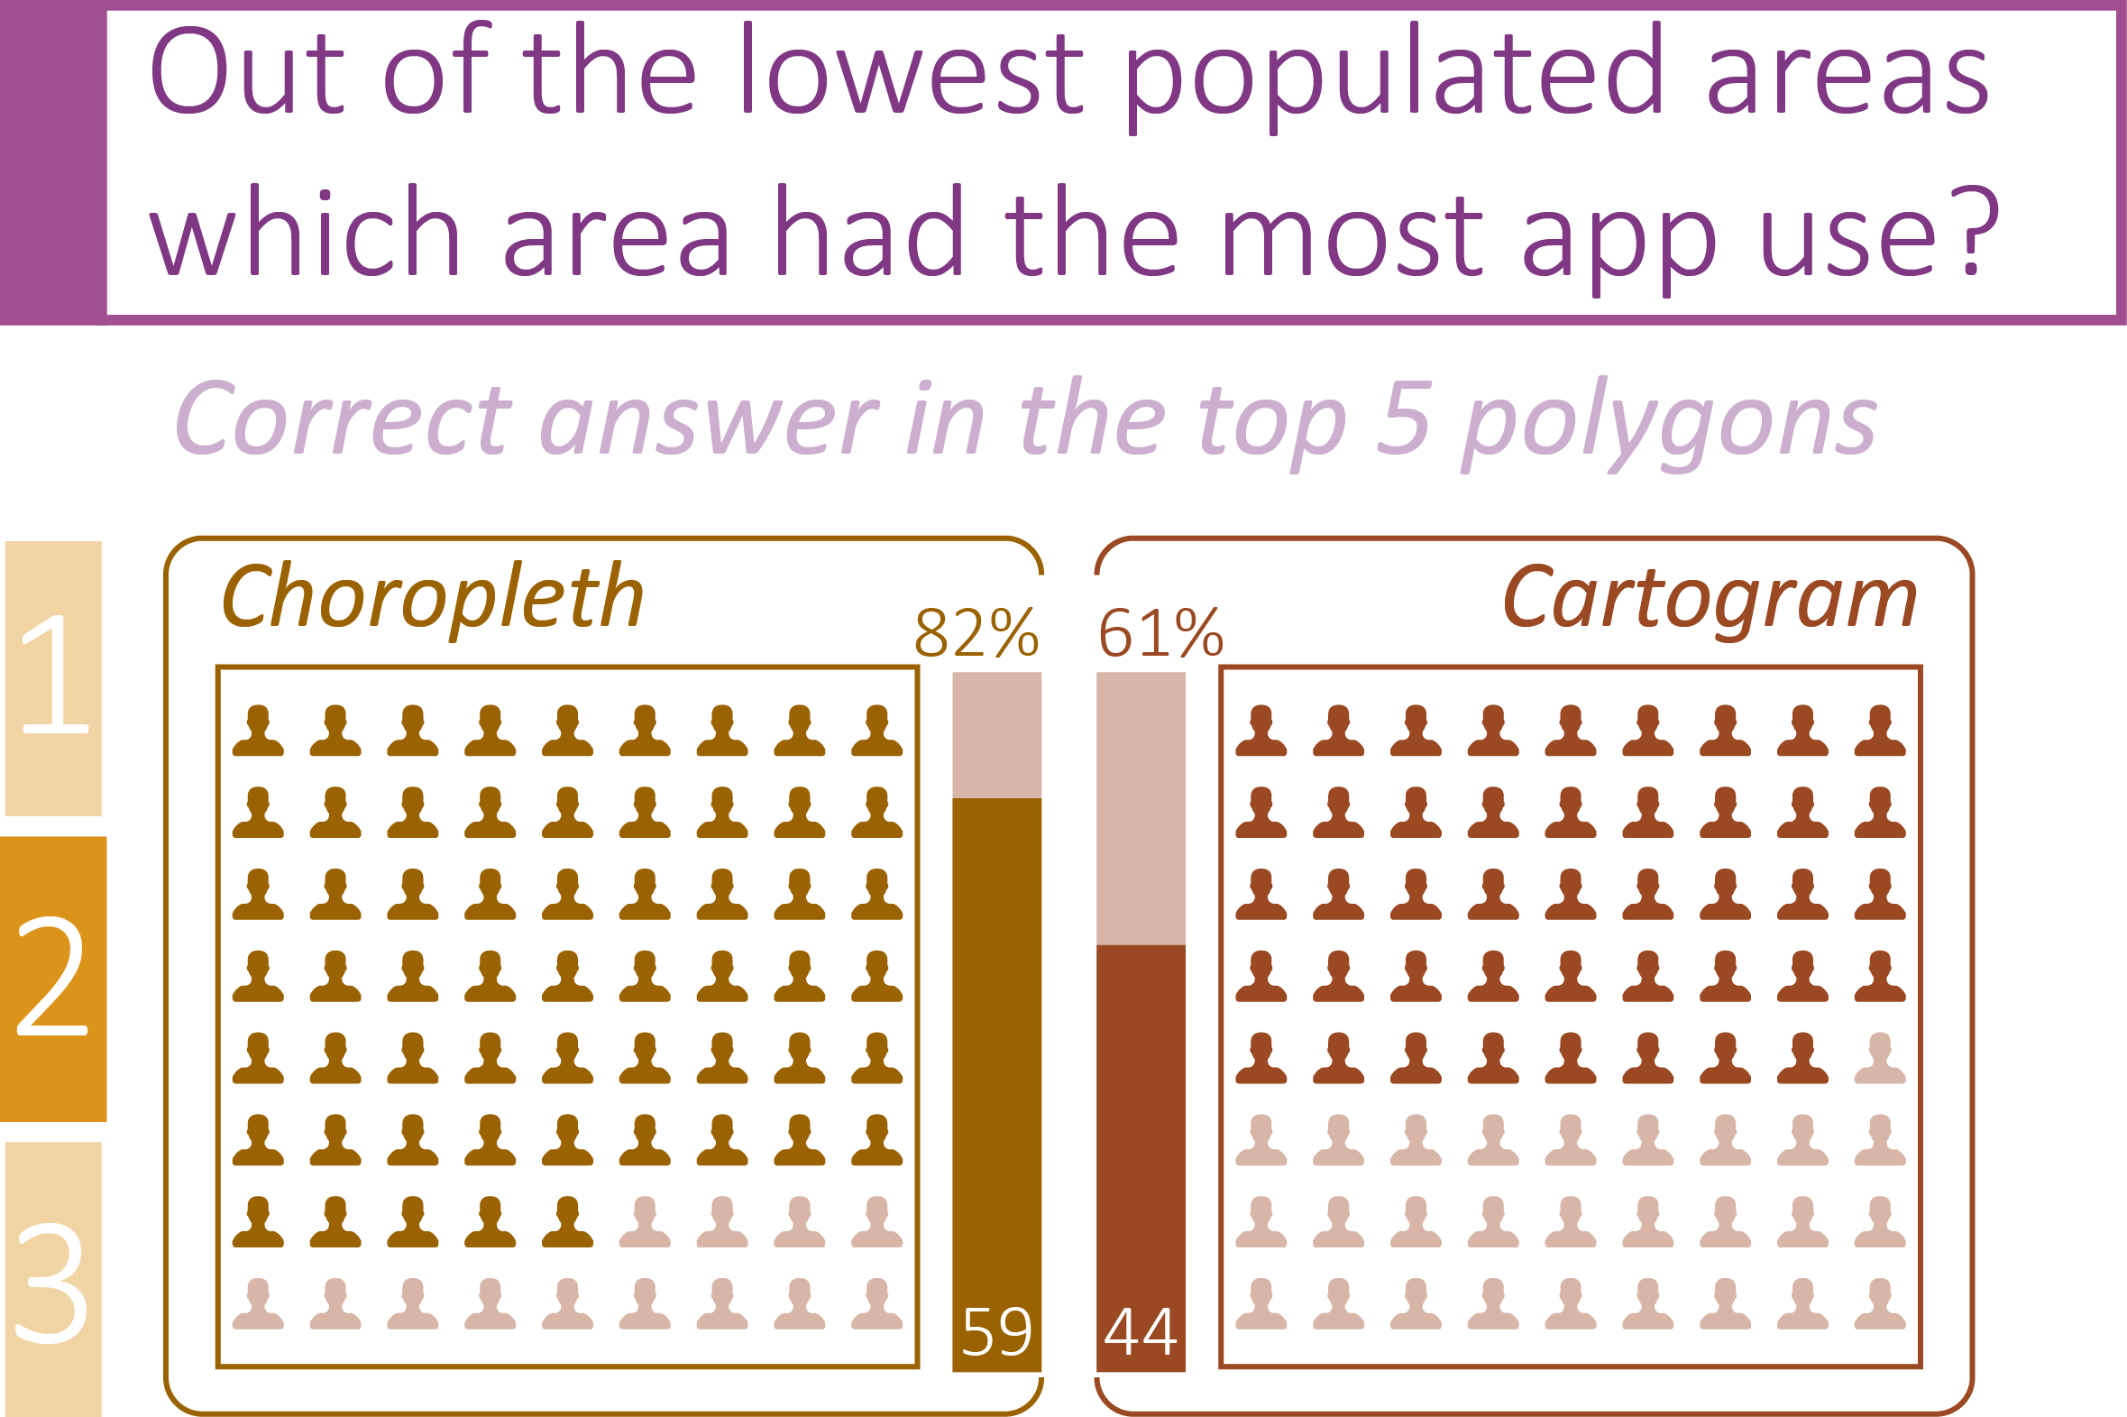

Slide 46
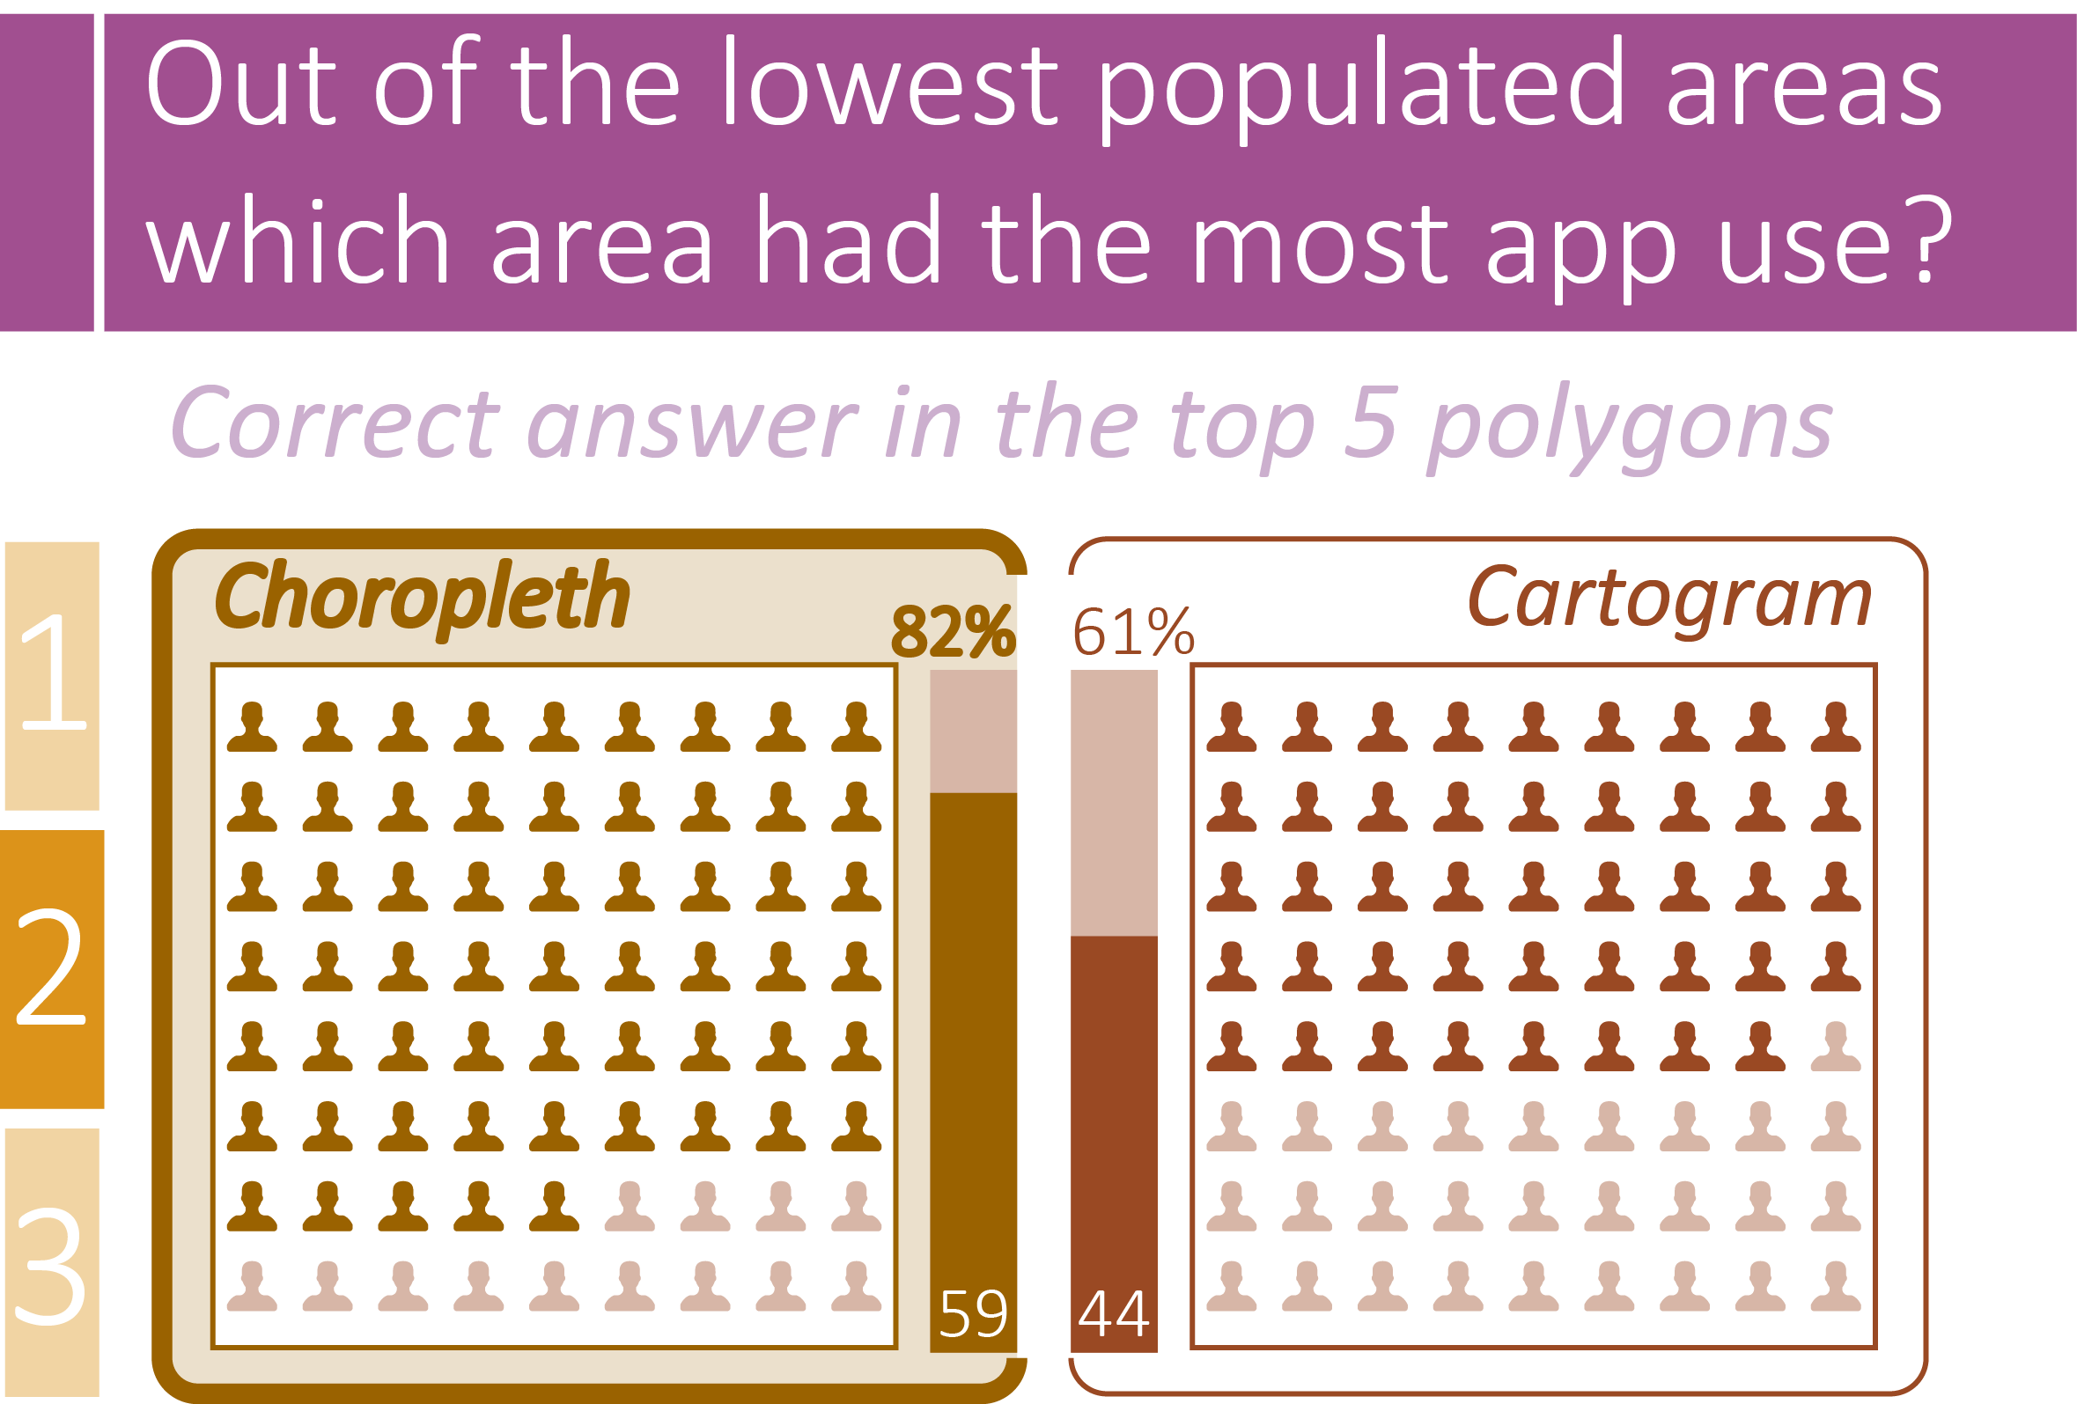

Slide 47
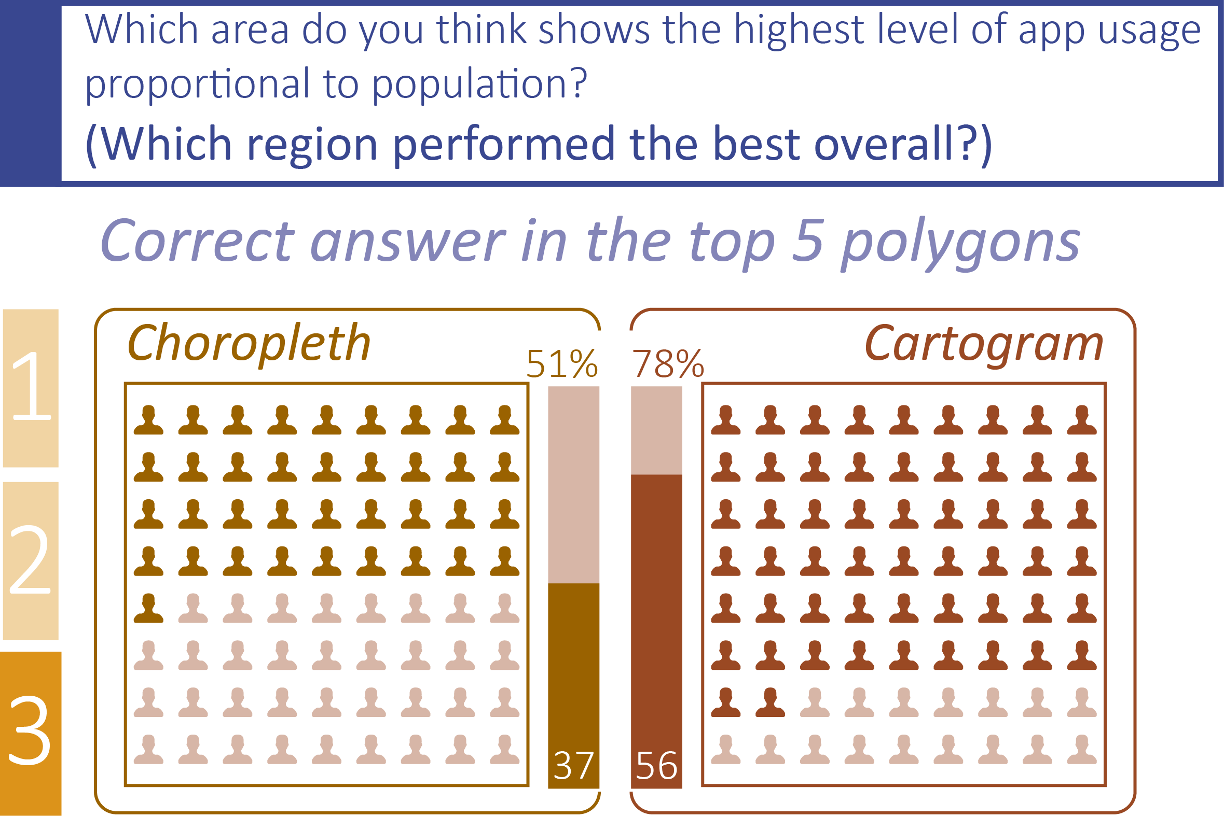

Slide 48
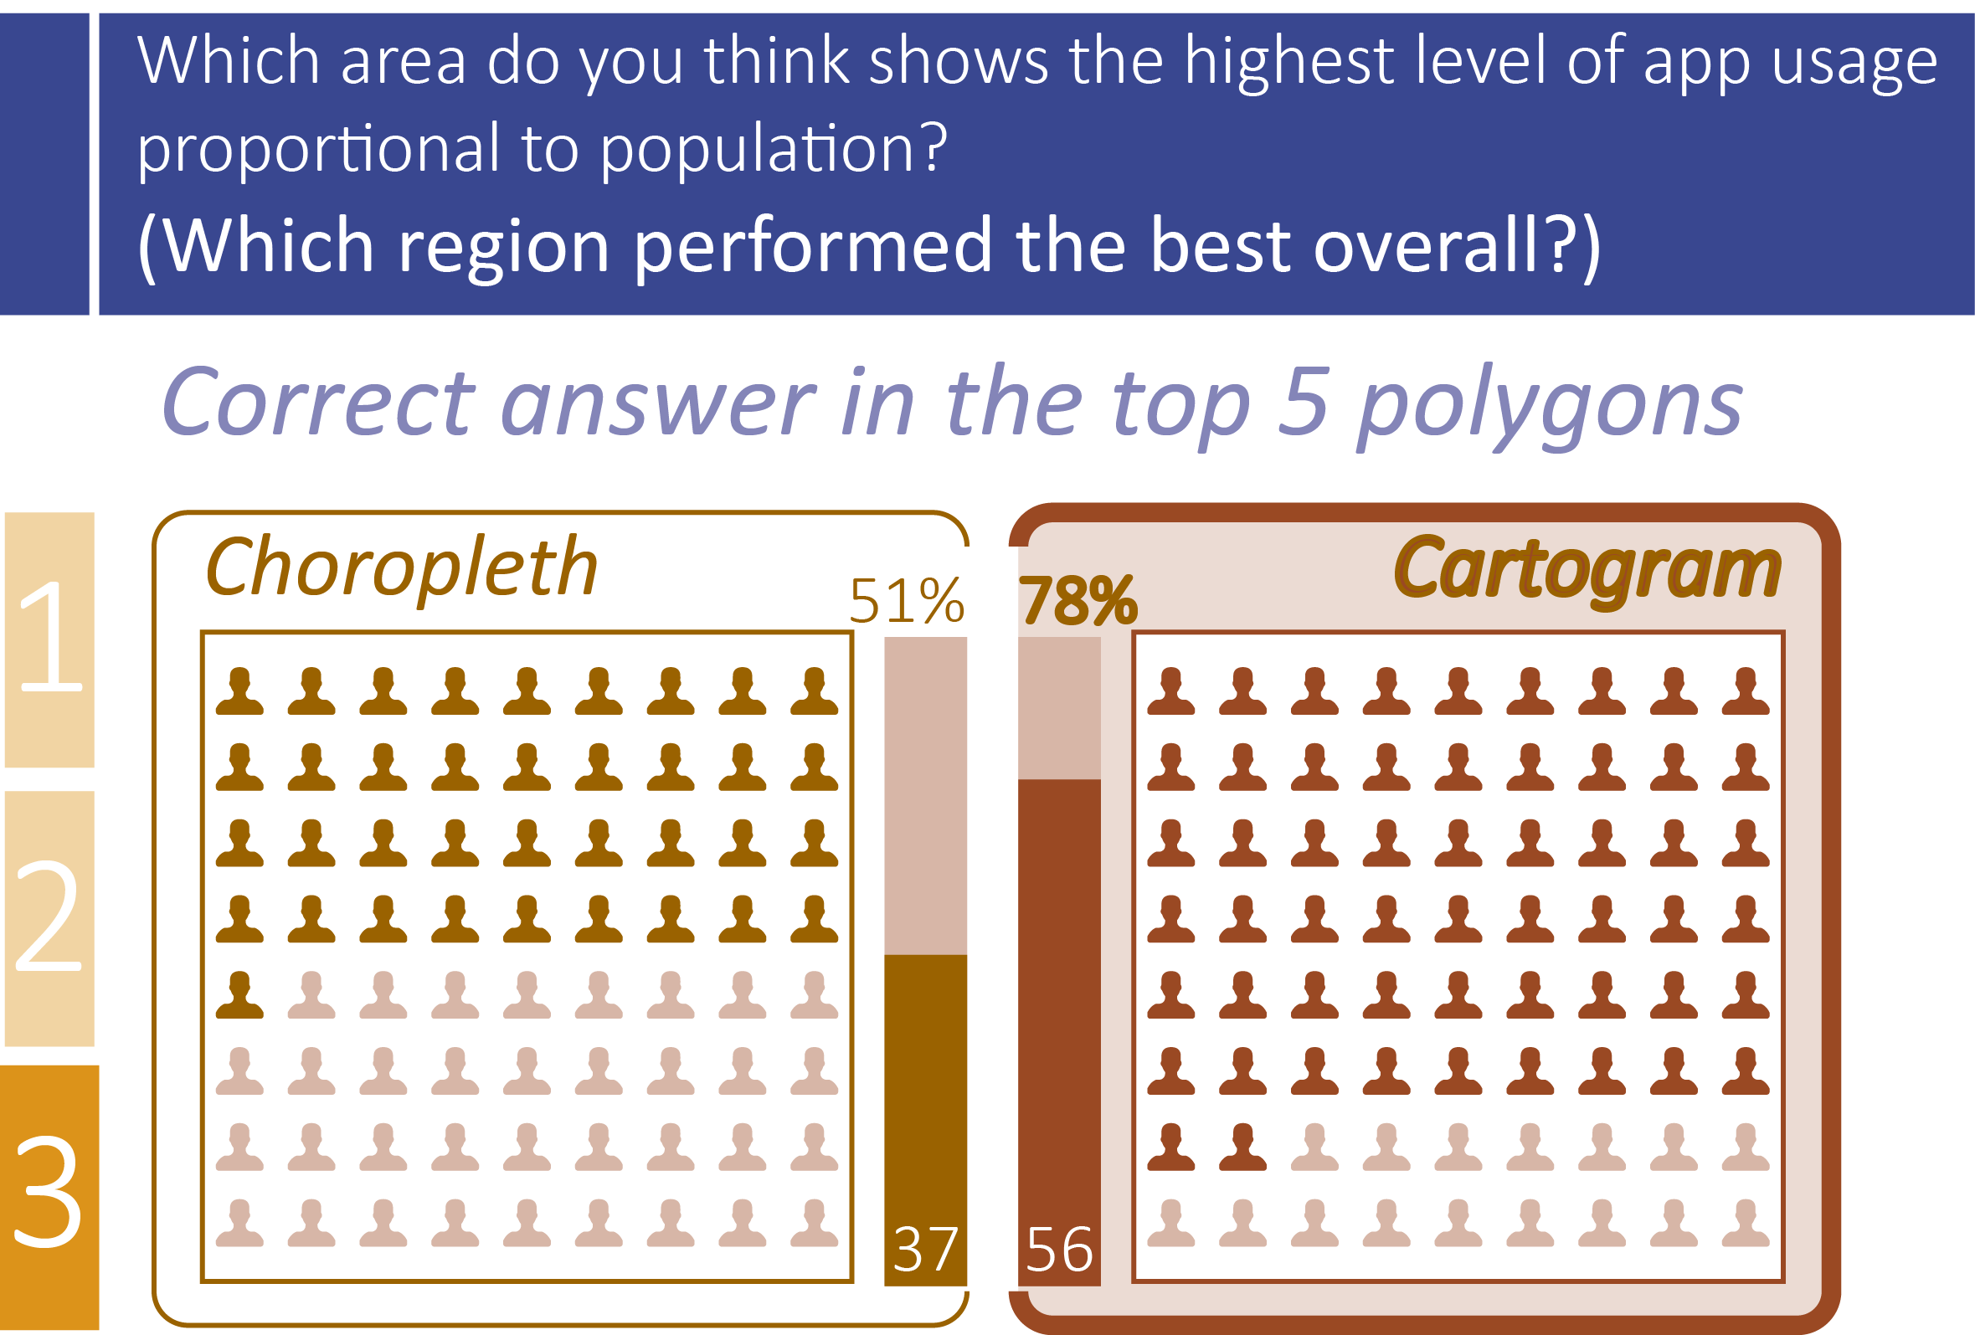

Slide 49
The Results
Age

Slide 50
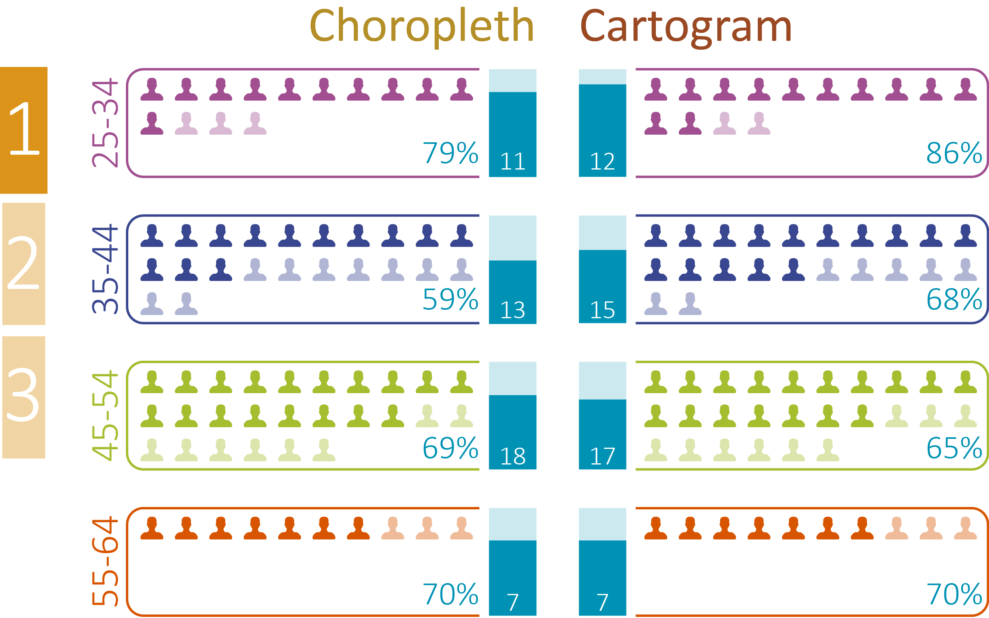
Age of participants
Correct answer in the top 5 polygons
Notes:
Clive comes in here…
Out of the highest populated areas which area had the least app use?
No swing in favour above 9% but the cartogram has the edge overall.

Slide 51
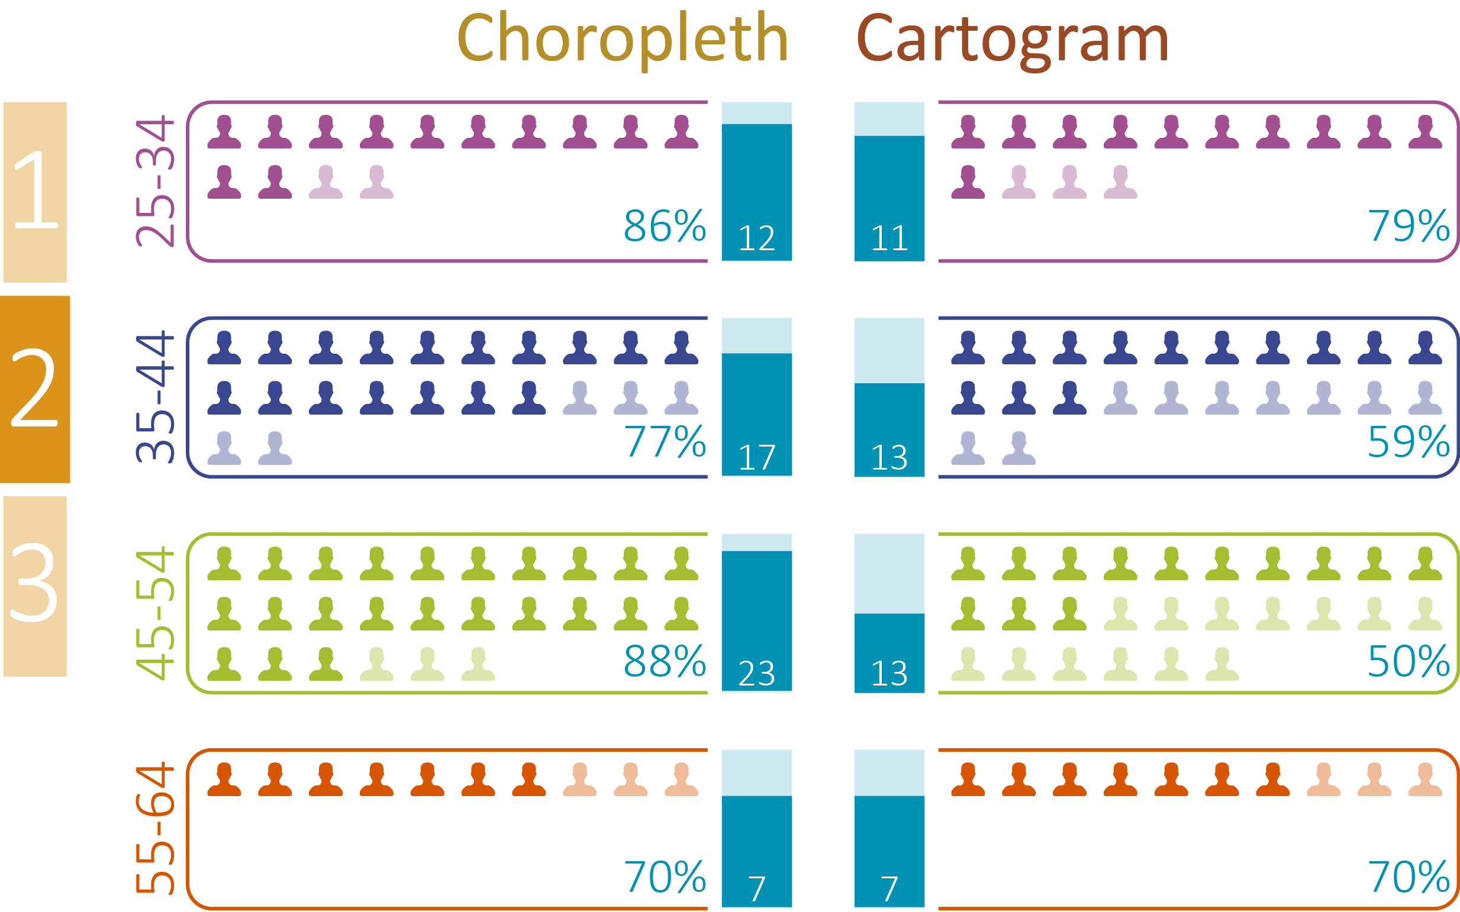
Age of participants
Correct answer in the top 5 polygons
Notes:
Out of the lowest populates areas which area had the most app use?
This is where the choropleth makes a significant gain over the cartogram, especially for the sizable 45-54 age group with a 38% lead.

Slide 52
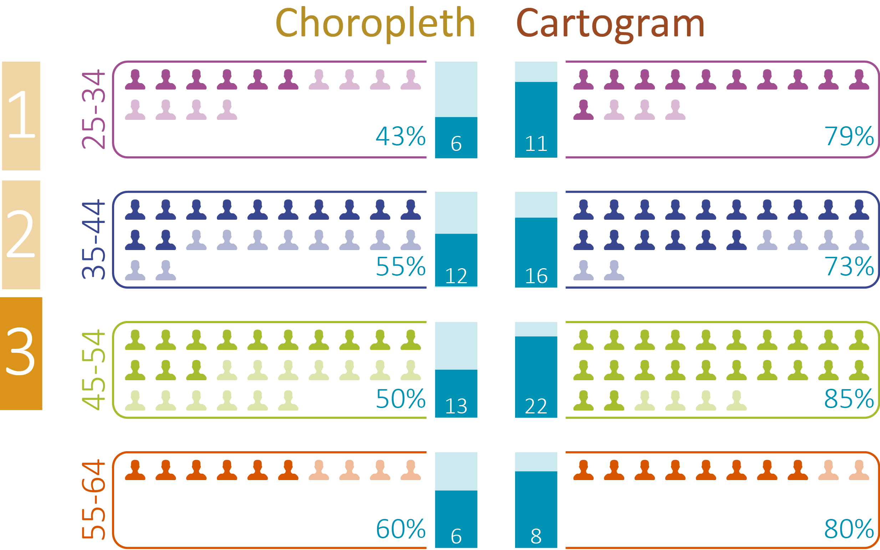
Age of participants
Correct answer in the top 5 polygons
Notes:
Which region performed best overall?
Now a complete reversal in fortune for the choropleth maps, giving way to the cartogram by an average of around 27% with the 25-34 and 45-54 age groups leading the way.

Slide 53
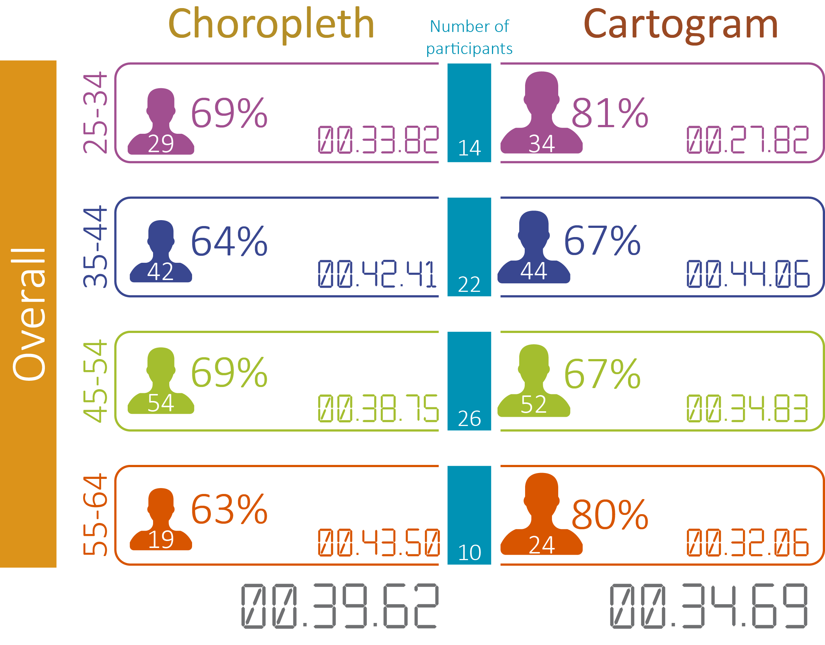
Age of participants
Notes:
The times overall generally show cartograms to be faster to digest, with only a marginal swing to the choropleth for the 35-44 age group.
OVERALL the choropleth maps take on average 5 seconds longer to read than the cartogram.

Slide 54
The Results
Map preference

Slide 55
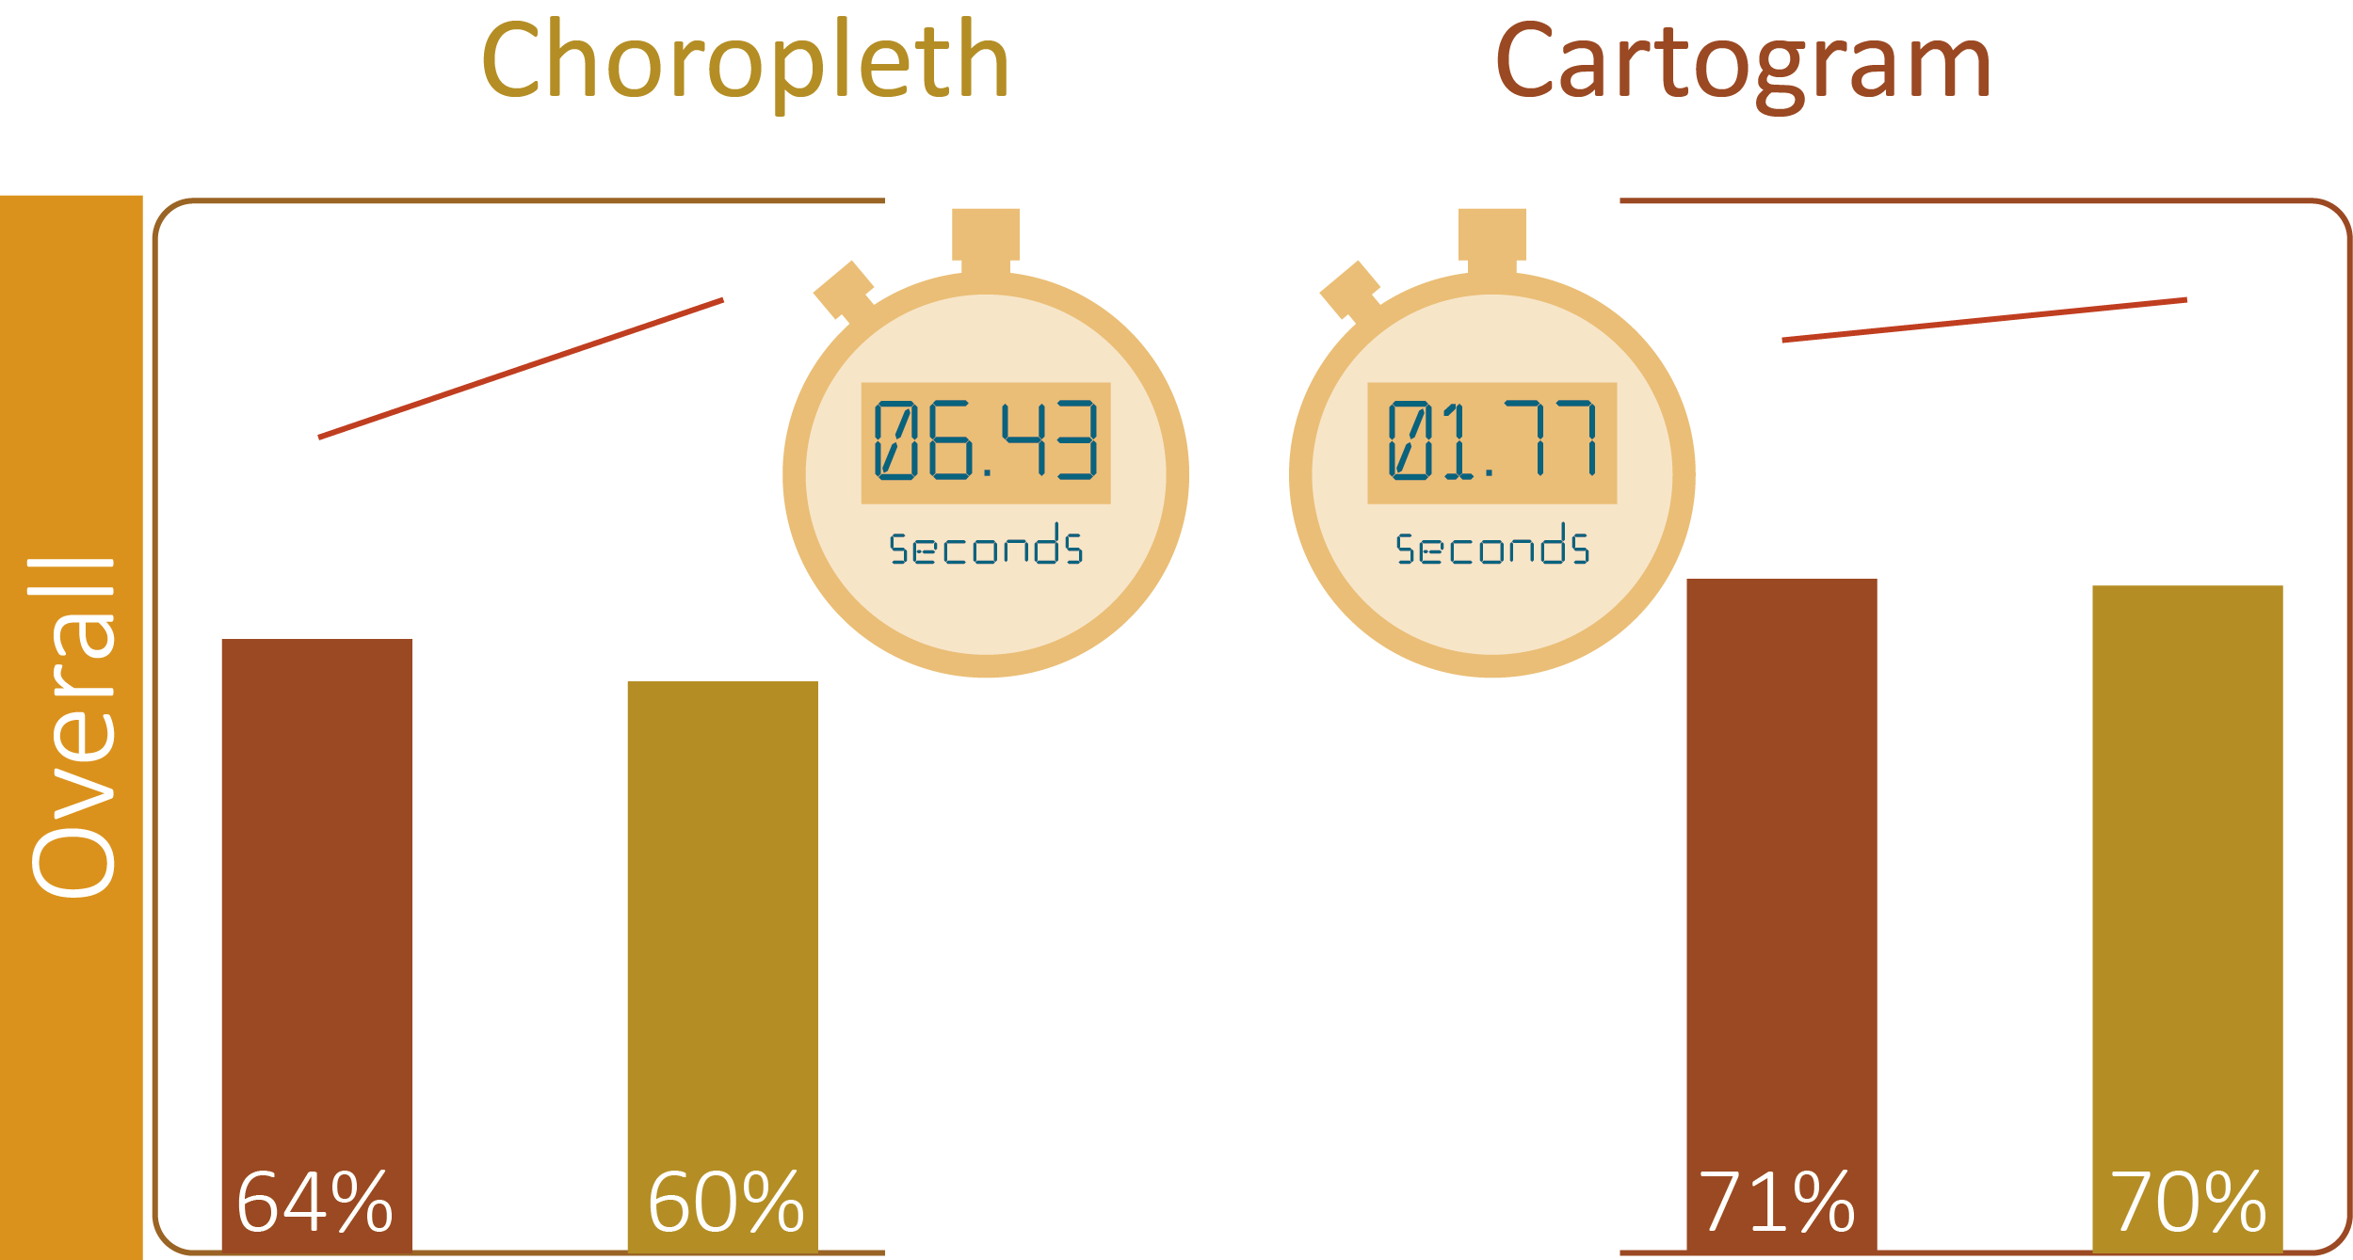
Map preference
Notes:
Overall, the cartogram was easier to read with a significant gain of nearly 7 seconds over the choropleth, in the choropleth camp.

Slide 56
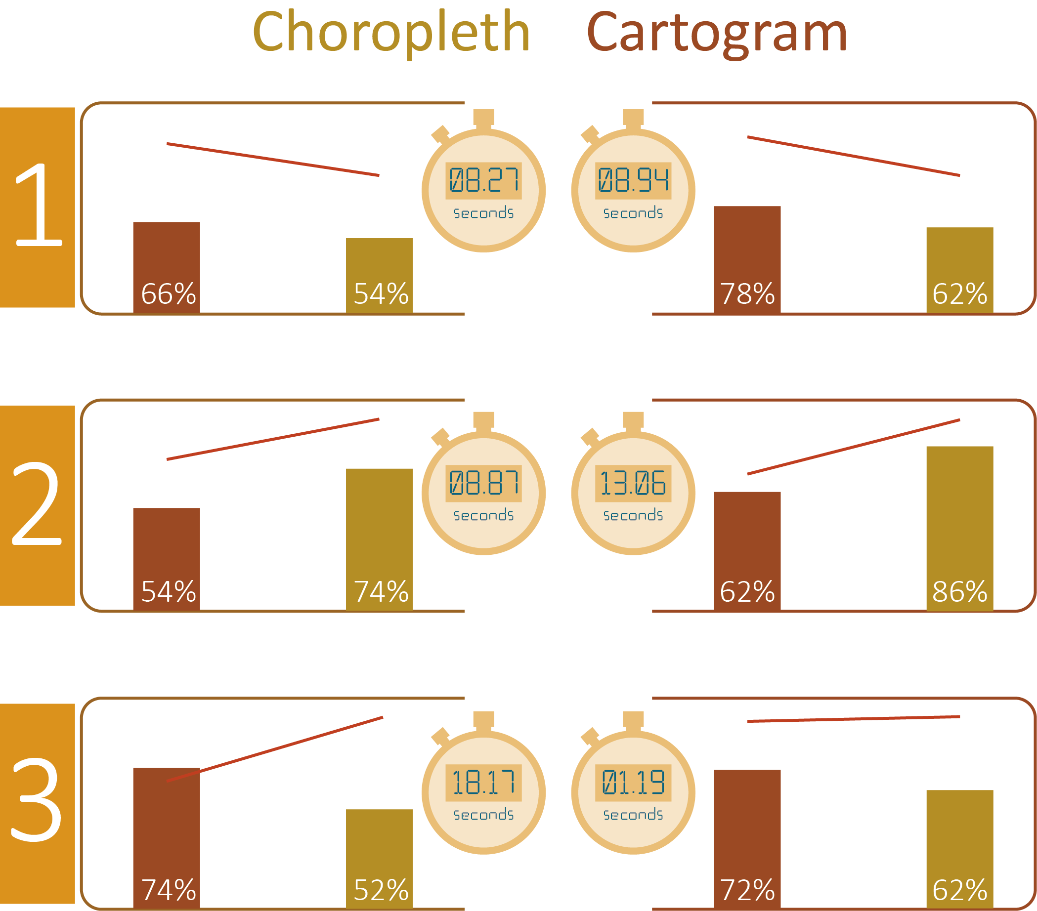
Map preference
Notes:
Here we separated the participants into those that preferred choropleth maps and those that preferred cartograms. 75% of all participants preferred the choropleth, but look at the results…
As witnessed before, both question 1 & 3 show the cartogram to be the most efficient communicator, and taking a closer look at Q3 reveals the only half of the choropleth group managed to read it, and it took twice the length to do so.
And Q2 continues to follow the trend in favour of the choropleth, even though it took the participant a few seconds longer to read. This is also evident in the cartogram camp, too.

Slide 57
Conclusion & Future Work
Notes:
Well, well, well…

Slide 58
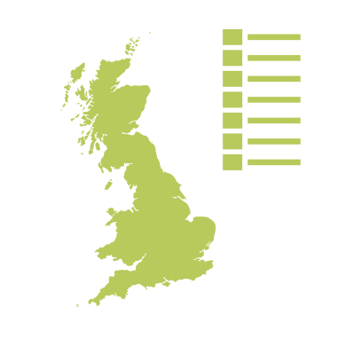
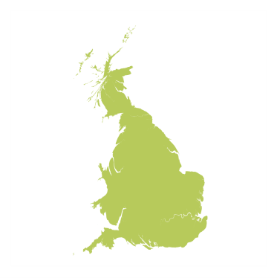
Is better at answering ‘complex’ questions
Familiarity of choropleth maps preferred
Difficulty in comparing two maps to get an answer
Does not communicate absolute values when they are categorised to colours
MAUP size bias
Communicates correctly 5 seconds faster
Is better at answering ‘simple’ questions
Poorer at communicating values that significantly reduce polygon size
Only 25% preferred cartograms
Conclusion
Notes:
How qualitative data is inappropriate for distorting the cartogram whereas it can be used for the colour.
Cartograms can be seen as a gimmick but exposure through magazine articles for example is helping with familiarisation.
Linking between the two choropleth maps appears to be partly responsible for the slower communicative ability.
Choropleth colours are ‘binned’ into categories, and depending on the base map, can be susceptible to the modifiable areal unit problem (MAUP).

Slide 59
Colour bias evident when a range of values represented by colour, especially for the choropleth maps
Ratios were confusing – a colour scale with a simple key would be far more effective
Accuracy was lower for cartograms the more complex the question became
Each type of map has an appropriate place to be used
Conclusion
Notes:
Will BGS use cartograms though?
Ratio far less effective in the mySoil data than the iGeology data. This was because the dataset is far small and the large numbers in the colour range proved confusing. Overall performance is poorer.
Accuracy was higher for choropleth maps the more complex the question became as noted in (Kaspar, Fabrikant, & Freckmann, 2011)

Slide 60

Colour – how people interpret colour?
Attraction – what draws people’s attention?
Visualisations – what else can be used to communicate this information?
Cartograms – further research into other cartogram types including ‘hybrid’ cartograms
Interactive maps – how choropleth maps and cartograms are used in this context
The Future

Slide 61
Thank-you
Any questions?

